Slide 1
San Diego Clean Cities Propane Landscaping Equipment Workshop
Event Check-in |  | 11:15 AM
Introduction Kevin Wood, SD Clean Cities |  | 11:30 AM
Propane Equipment and Benefits Clay Johnson, Amerigas |  | 11:45 AM
Closing Remarks Steve Moore, Expo Propane |  | 12:30 PM
Q&A Discussion |  | 12:40 PM
Networking Lunch and Equipment Showcase |  | 1:00 PM

Slide 2
Propane Landscaping Equipment Workshop
Kevin Wood, Coordinator
December 8, 2015

Slide 3
Clean Cities
U. S. Department of Energy Clean Cities Program
Mission - To advance the energy, economic, and environmental security of the U.S. by supporting local decisions to reduce petroleum use in transportation.
The San Diego Regional Clean Cities Coalition was established in 1996 to:
Build partnerships to support clean vehicle deployment
Promote alternative fuels including: Electricity, propane, natural gas, biodiesel and ethanol
Help fleets and consumers make informed decisions about fuel technologies
Notes:
My name is Kevin Wood and I am the coordinator of the San Diego Regional Clean Cities Coalition. We were established in 1996 as part of the U.S. Department of Energy’s Clean Cities Program.
Clean Cities Mission is to:
“To advance the energy, economic, and environmental security of the U.S.
by supporting local decisions to reduce petroleum use in transportation.”
San Diego Clean Cities is dedicated to reducing regional petroleum consumption and emissions through the deployment of alternative fuel and advanced technology vehicles. The Coalition‘s public, private, and nonprofit members work together to help fleets and consumers make informed choices on alternative fuels and fuel economy and overcome barriers to the greater adoption of clean transportation technologies.

Slide 4
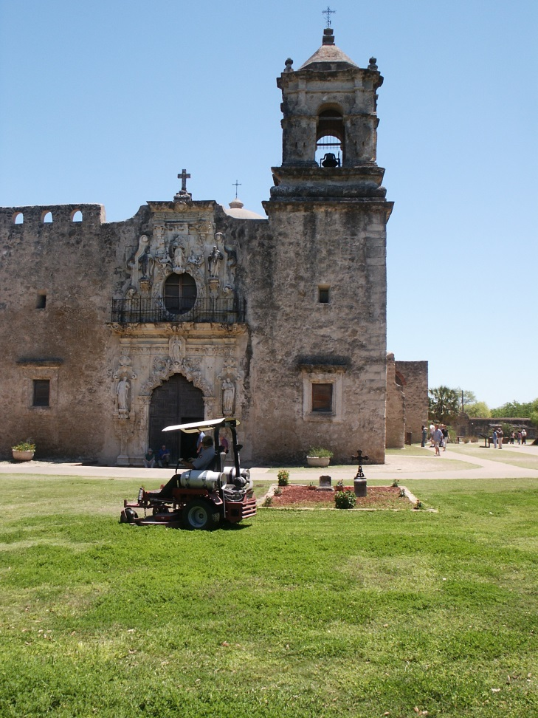
Propane Basics
Stored under pressure inside a tank as a colorless, odorless liquid
By-product of natural gas processing and crude oil refining
High octane rating, high energy content
3rd most common transportation fuel
Notes:
Also referred to as liquefied petroleum gas (LPG)
19 propane stations in region

Slide 5
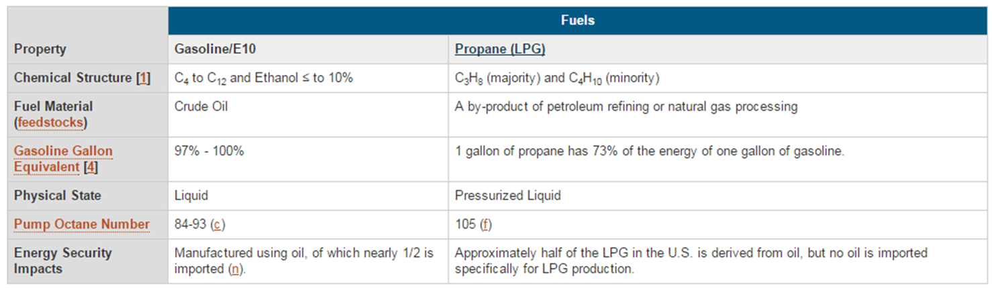

Propane vs. Gasoline
Notes:
Propane is domestically produced
73% of energy content as gasoline
15-20% lower GHG emissions than gasoline vehicle
propane tanks are 20 times more puncture resistant than gasoline tanks, and propane has the lowest flammability range of all alternative fuels.
Clean-burning characteristics allow increased engine service life

Slide 6
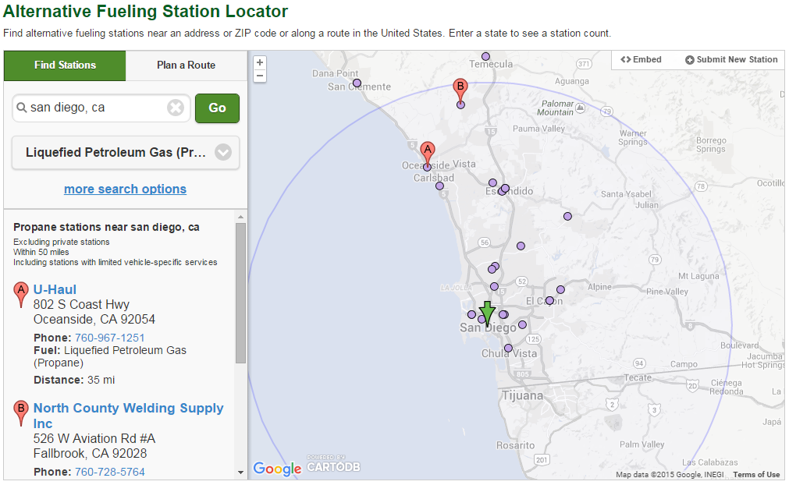
Fueling Stations
Notes:
Station Locator is one of the most Used tools on the AFDC
Stations are searchable by fuel type and route.
Contains stations hours and payment type
The coalition submits updates when a new station opens or if we identify any changes
19 propane stations in region

Slide 7
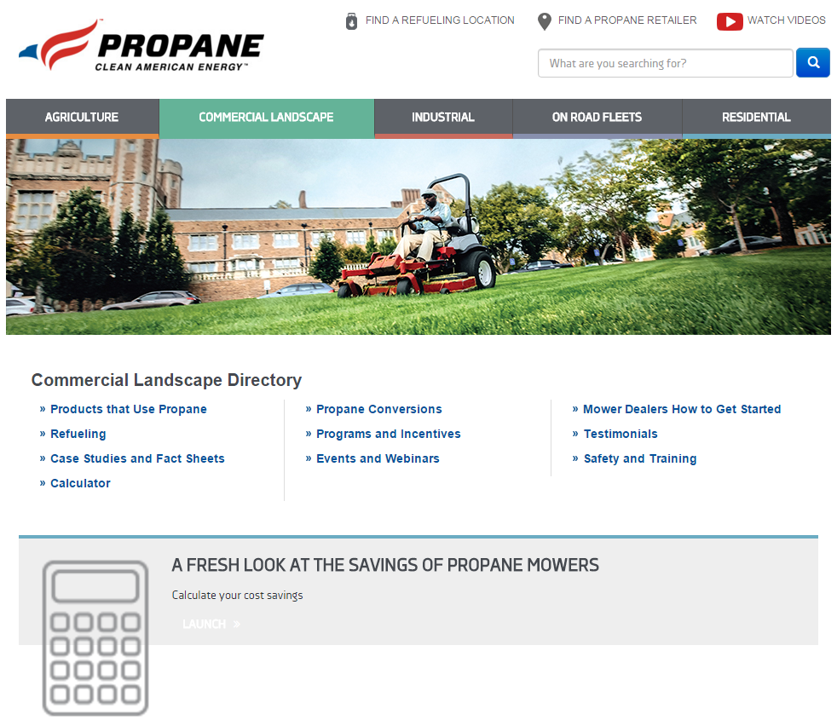
Additional Resources
San Diego Regional Clean Cities Coalition
SDcleancities.org
Alternative Fuels Data Center
afdc.energy.gov
Propane Education & Research Council propane.com

Slide 8
Contact Information
Kevin Wood
San Diego Regional
Clean Cities Coalition
858-244-7295
Kevin.Wood@energycenter.org

Slide 9
San Diego Clean Cities Propane Landscaping Equipment Workshop
Event Check-in |  | 11:15 AM
Introduction Kevin Wood, SD Clean Cities |  | 11:30 AM
Propane Equipment and Benefits Clay Johnson, Amerigas |  | 11:45 AM
Closing Remarks Steve Moore, Expo Propane |  | 12:30 PM
Q&A Discussion |  | 12:40 PM
Networking Lunch and Equipment Showcase |  | 1:00 PM

