Slide 1
School Bus Electrification Lunch & Learn
01/09/2024
San Diego Regional Clean Cities Coalition (SDRCCC)
Francis Alvarez, Co-director
John Anderson, Co-director

Slide 2
Agenda
10:00 AM – Introduction
10:15 AM – Cajon Valley Presentation
10:30 AM – Nuvve Presentation
11:00 AM – Energetics Presentation
11:20 AM – SDG&E Presentation
12:00 PM – Site Walk
1:00 PM – Lunch & Networking with Highland Fleets
1:45 PM – Clean Cities Closeout & Survey
2:00 PM – Adjourn

Slide 3
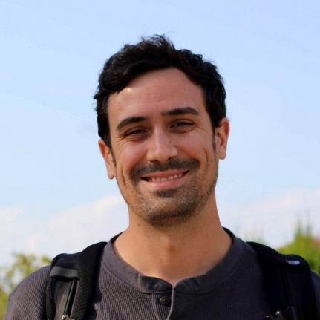
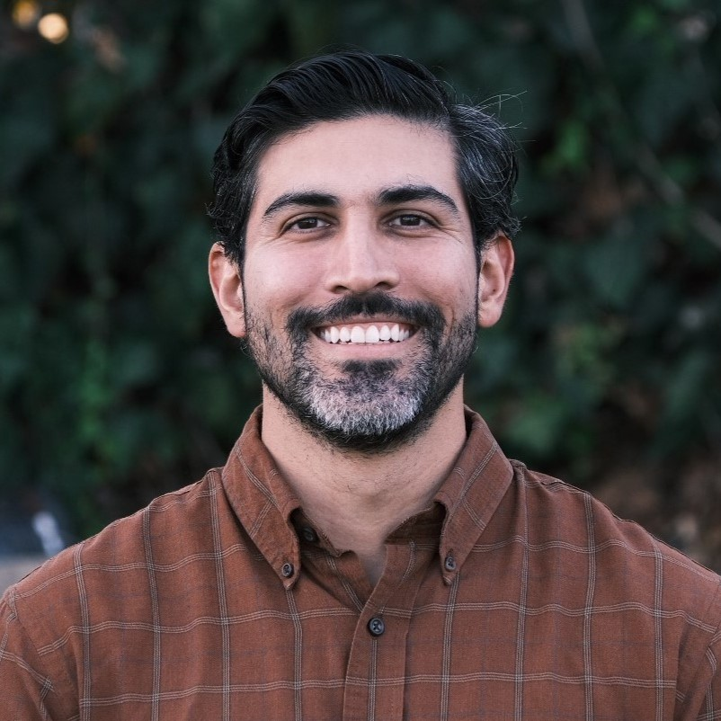
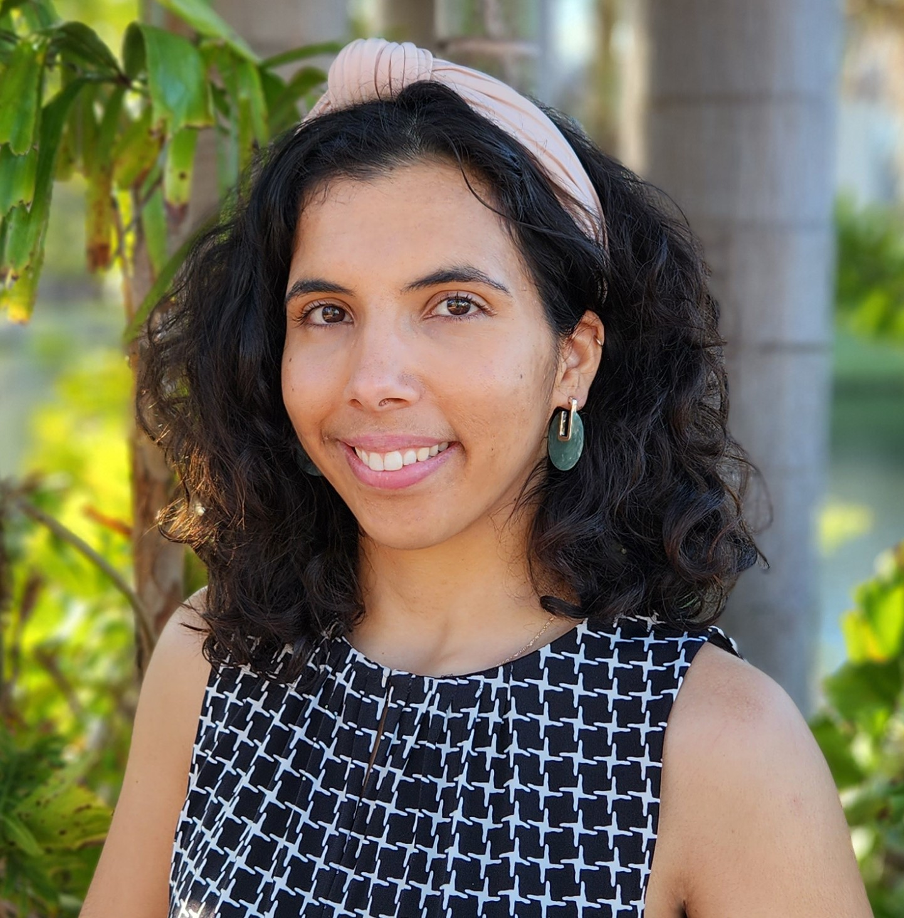
San Diego Clean Cities Team
John Anderson
Francis Alvarez
Mina Afayee
Co-Director
Co-Director
Project Manager

Slide 4
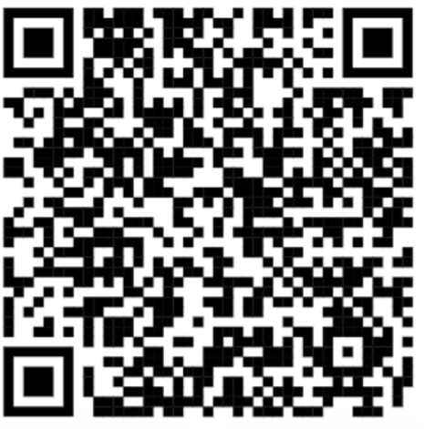
Sign an EMPOWER Workplace Charging Pledge!
Some benefits of signing a pledge include:
Free Consulting To Support Workplace Charging
A Certificate To Showcase Your Workplace Is EV Friendly
Access To Resources To Help Further Your Workplace Charging
Recognition For Being An EV Friendly Workplace
To learn more, go to workplacecharging.com.
Sign a pledge today online or ask Francis for a paper pledge!

Slide 5
Workplace Charging - EMPOWER
EMPOWER Pledge Form
(~2 min to sign and can be signed by any staff member)
EMPOWER Pledge and Installation Form
(to sign pledge and if there are workplace chargers installed after April 1, 2022)
We can fill out installations for you as well. Email us at sdrccc@energycenter.org
Opportunity to win a charger!
How to enter:
Like, comment, or repost post
Fill out short form

Slide 6
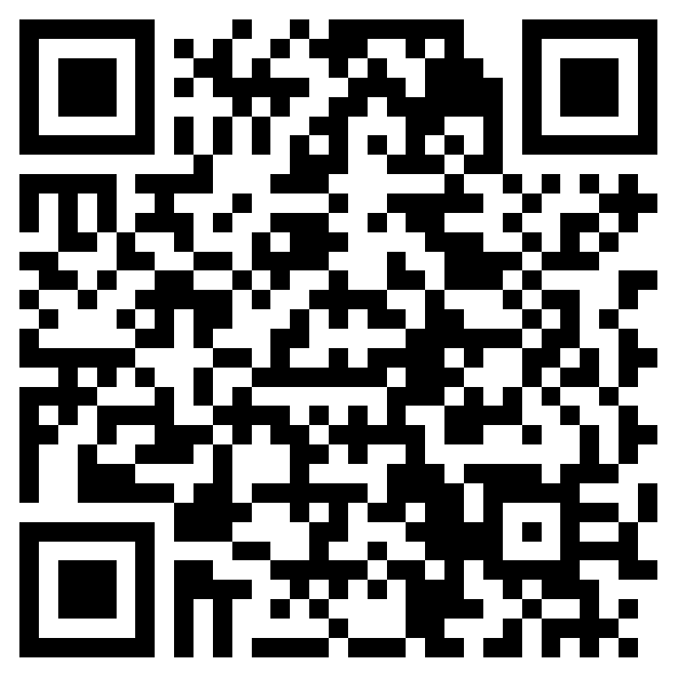
Lunch & Learn Event Feedback
Email: sdrccc@energycenter.org
Website: https://sdcleancities.org/
LinkedIn: https://www.linkedin.com/company/sdrccc
https://forms.office.com/r/WPqyDzUtMY

Slide 7
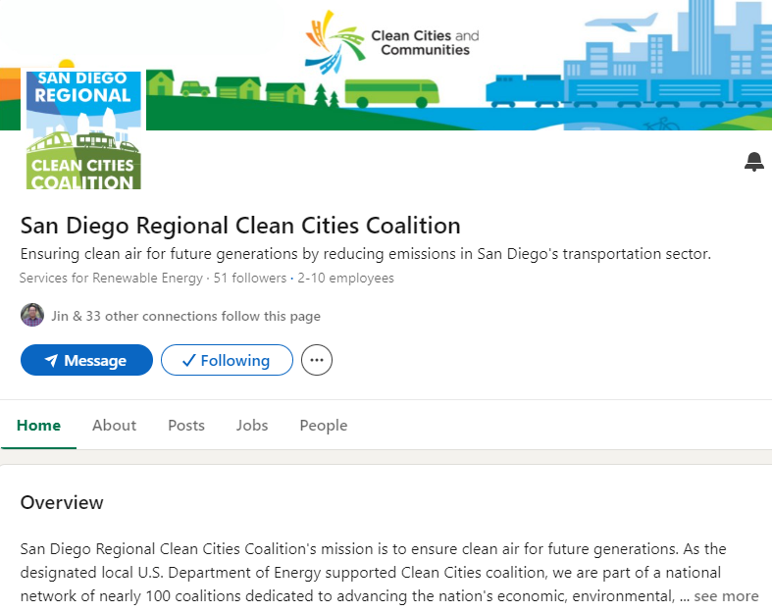
Follow SDRCCC on LinkedIn or sign up for our newsletter for updates, funding opportunities, events, and more!

Slide 8
Thank you for attending!
We will send a follow up email with all materials from today.
If you didn't RSVP, please share your email address with Francis, or email us at sdrccc@energycenter.org so we can get those resources sent to you.

