Slide 1
San Diego Regional Clean Cities School Bus Electrification - Lunch & Learn 1/9/25 Energetics, CLEAResult Energy Sustainability Consulting Jason Greenblatt & Kevin Wood

Slide 2
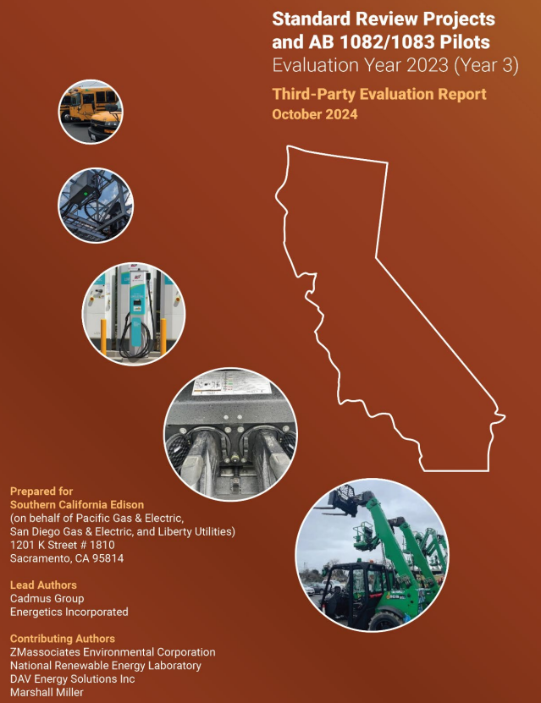
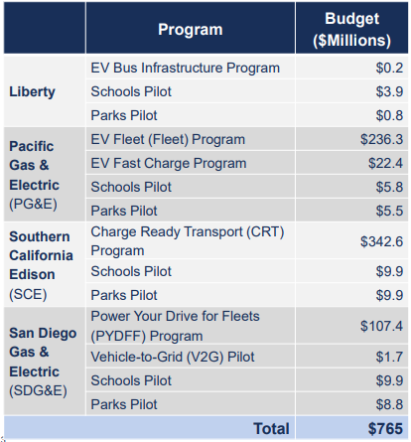
Evaluation Year 3 (2023)
Fleet, Public& Workplace Charging Investments

Slide 3
Pritchard Hierarchy of Electric Vehicle Charging
Make sure assets provide vehicle utilization
Then do the special stuff
Iterate, assess, implement, reassess along the way

Slide 4
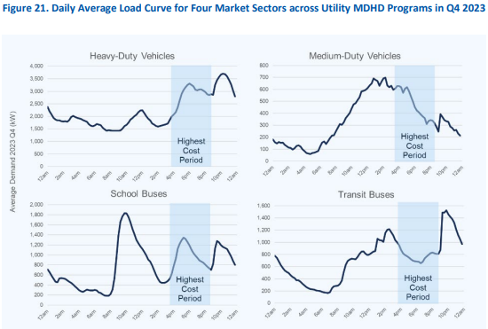
School bus (and other markets) Charging Operations AMI (utility meter data)
Typical morning peak at 10AM
<5 hours of dwell time
Typical evening charging
>12 hours of dwell time
Two evening peaks
split by use of load management

Slide 5
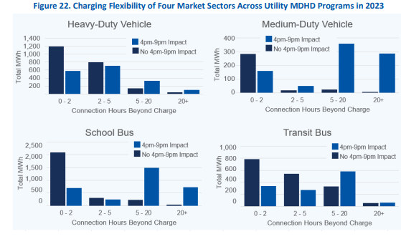
Network Service Provider (Charging Session) Data
Useful to characterize “charging flexibility”
Time stamps
Session start (plug in/out)
Power draw (start/end)
Consumption and demand
EVSE/port

Slide 6
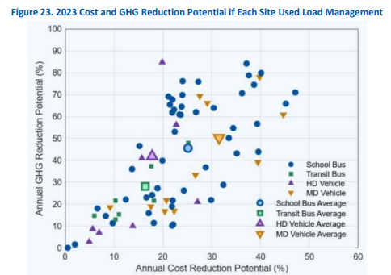
Plentiful Opportunity to Save $$$ on Monthly Utility Bills
Cost and GHG analysis based on Charging Flexibility & hardware
Other utilities have aligned Super Off Peak (lowest cost times) with least emissions times
SDG&E is in process with CPUC
Optimization prioritized Cost savings
Following Year 4 (2024) analysis to dig into emissions optimization

Slide 7
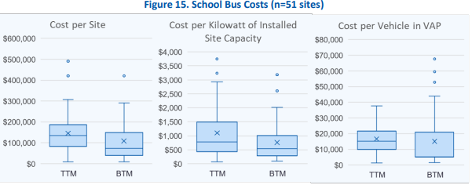
General Reporting Awareness
Costs by Site, installed kW, Vehicle
See also HD, MD, Transit Bus

Slide 8
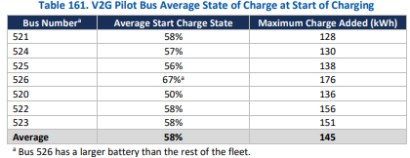
Cajon Valley EV and V2G Pilot
Unique option to jointly bill Building & EV Charging
Several years of operations
Early generation technology (buses and chargers)
Discharging under SDG&E’s ELRP in ‘22&’23 (as reported)
6 Borg Warner – Rhombus DC chargers
Mix of bus generations
45-60kw charging
25-45 kw discharge
120-210 kWh
One data logger swapped mid project to another bus
Significant mix of DC & Level 2 Charging
L2 an indicator of DC issues
results in limiting V2G
Significant energy remaining in battery after each driving shift

Slide 9
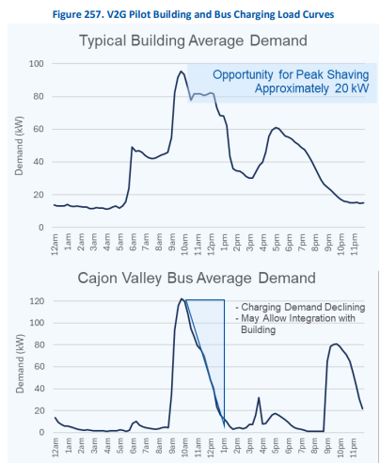
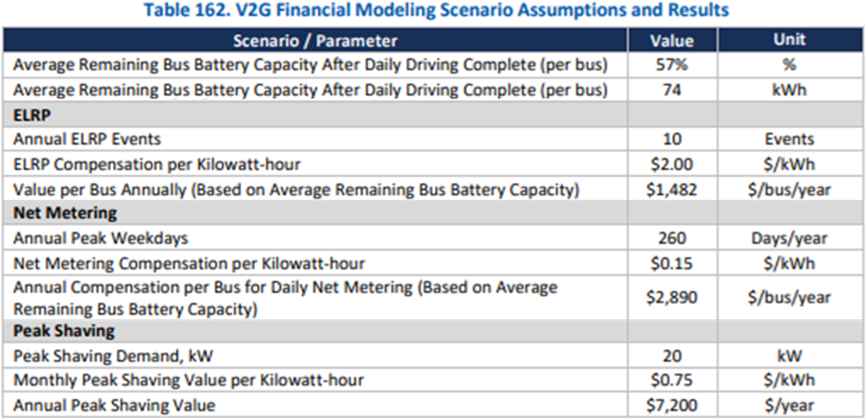
Bus and Building Experience and Modeling
(small for 6-chargers & buses)
365 - Daily
Limited (~50) hours of annual ELRP availability
Increase usable hours throughout year with Net Metering (>500%) and Peak Shaving (>900%)
Some opportunity to charge before On Peak
Prepare for energy-price arbitrage from Net Metering discharge
Future V2G oriented rates on horizon

Slide 10
Considerations
Funding options towards projects
Rule 45, SB350, HVIP, etc.
Easements, ownerships/site control, etc.
Power capacity and access
How can different electricity consumption needs work together?
Options re: billing tariffs, programs
New VGI oriented tariffs from each IOU
Continued demonstration projects (PG&E V2X and SCE Rialto USD, Large Oakland Unified Zum V2G)

