Slide 1
Stabilizing the Grid with Vehicle to Grid (V2G) Technology
January 9, 2025

Slide 2
AGENDA
Nuvve Introduction
Nuvve’s Mission
Bi-directional Solution
Nuvve's Platform & Services
Cajon Valley Union School District- V2G Host site
ELRP Program Results
V2G & Battery Health
Q&A
Notes:
Nuvve is a public company so I am compelled to make the following disclosures.
All views I express are my own.
This is not a solicitation to sell securities or give investment advice.
This presentation may contain forward-looking statements that are for illustrative purposes only.
Additional information concerning risk factors that could cause results to differ materially is contained in our most recent SEC filings on Form 10-K and Form 10-Q, available at the investor tab of our website.
Past performance is not indicative of future results.

Slide 3
Legal Disclaimer
This presentation (this “Presentation”) is provided for information purposes only and has been prepared to assist interested parties in making their own evaluation with respect to a potential business combination between Newborn Acquisition Corp. (“Newborn” or “NBAC”) and Nuvve Corporation (“Nuvve” or the “Company”) and related transactions (the “Proposed Business Combination”) and for no other purpose.
No representations or warranties, express or implied are given in, or in respect of, this Presentation. To the fullest extent permitted by law in no circumstances will NBAC, Nuvve or any of their respective subsidiaries, stockholders, affiliates, representatives, partners, directors, officers, employees, advisers or agents be responsible or liable for any direct, indirect or consequential loss or loss of profit arising from the use of this Presentation, its contents, its omissions, reliance on the information contained within it, or on opinions communicated in relation thereto or otherwise arising in connection therewith. Industry and market data used in this Presentation have been obtained from third-party industry publications and sources as well as from research reports prepared for other purposes. Neither NBAC nor Nuvve has independently verified the data obtained from these sources and cannot assure you of the data’s accuracy or completeness. This data is subject to change. In addition, this Presentation does not purport to be all-inclusive or to contain all of the information that may be required to make a full analysis of Nuvve or the Proposed Business Combination. Viewers of this Presentation should each make their own evaluation of Nuvve and of the relevance and adequacy of the information and should make such other investigations as they deem necessary.
Forward Looking Statements
Certain statements included in this Presentation that are not historical facts are forward-looking statements for purposes of the safe harbor provisions under the United States Private Securities Litigation Reform Act of 1995. Forward-looking statements generally are accompanied by words such as “believe,” “may,” “will,” “estimate,” “continue,” “anticipate,” “intend,” “expect,” “should,” “would,” “plan,” “predict,” “potential,” “seem,” “seek,” “future,” “outlook,” “model,” “target,” “goal,” and similar expressions that predict or indicate future events or trends or that are not statements of historical matters. These forward-looking statements include, but are not limited to, statements regarding estimates and forecasts of other financial and performance metrics and projections of market opportunity. These statements are based on various assumptions, whether or not identified in this Presentation, and on the current expectations of NBAC’s and Nuvve’s management and are not predictions of actual performance. These forward-looking statements are provided for illustrative purposes only and are not intended to serve as, and must not be relied on by any investor as, a guarantee, an assurance, a prediction or a definitive statement of fact or probability. Actual events and circumstances are difficult or impossible to predict and will differ from assumptions. Many actual events and circumstances are beyond the control of NBAC and Nuvve. These forward-looking statements are subject to a number of risks and uncertainties, including changes in domestic and foreign business, market, financial, political and legal conditions; the inability of the parties to successfully or timely consummate the Proposed Business Combination, including the risk that any required regulatory approvals are not obtained, are delayed or are subject to unanticipated conditions that could adversely affect the combined company or the expected benefits of the Proposed Business Combination or that the approval of the stockholders of NBAC or Nuvve is not obtained; failure to realize the anticipated benefits of the Proposed Business Combination; risks relating to the uncertainty of the projected financial information with respect to Nuvve; risks related to the organic and inorganic growth of Nuvve’s business and the timing of expected business milestones; the effects of competition on Nuvve’s future business; the amount of redemption requests made by NBAC’s stockholders; the ability of NBAC or the combined company to issue equity or equity-linked securities or obtain debt financing in connection with the Proposed Business Combination or in the future, and those factors discussed in NBAC’s final prospectus dated February 13, 2020 under the heading “Risk Factors,” and other documents of NBAC filed, or to be filed, with the Securities and Exchange Commission (“SEC”). If any of these risks materialize or our assumptions prove incorrect, actual results could differ materially from the results implied by these forward-looking statements. There may be additional risks that neither NBAC nor Nuvve presently know or that NBAC and Nuvve currently believe are immaterial that could also cause actual results to differ from those contained in the forward-looking statements. In addition, forward-looking statements reflect NBAC’s and Nuvve’s expectations, plans or forecasts of future events and views as of the date of this Presentation. NBAC and Nuvve anticipate that subsequent events and developments will cause NBAC’s and Nuvve’s assessments to change. However, while NBAC and Nuvve may elect to update these forward-looking statements at some point in the future, NBAC and Nuvve specifically disclaim any obligation to do so. These forward-looking statements should not be relied upon as representing NBAC’s and Nuvve’s assessments as of any date subsequent to the date of this Presentation. Accordingly, undue reliance should not be placed upon the forward-looking statements.
Use of Projections
This Presentation contains projected financial information with respect to Nuvve. Such projected financial information constitutes forward-looking information, and is for illustrative purposes only and should not be relied upon as necessarily being indicative of future results. The assumptions and estimates underlying such financial forecast information are inherently uncertain and are subject to a wide variety of significant business, economic, competitive and other risks and uncertainties. See “Forward-Looking Statements” above. Actual results may differ materially from the results contemplated by the financial forecast information contained in this Presentation, and the inclusion of such information in this Presentation should not be regarded as a representation by any person that the results reflected in such forecasts will be achieved.

Slide 4
Legal Disclaimer (cont.)
Financial Information; Non-GAAP Financial Measures
The financial information and data contained in this Presentation is unaudited and does not conform to Regulation S-X. Accordingly, such information and data may not be included in, may be adjusted in or may be presented differently in, any proxy statement/prospectus or registration statement to be filed by NBAC with the SEC, and such differences may be material. In particular, all Nuvve historical financial information included herein is preliminary and subject to change pending finalization of the audits of Nuvve for the years ended December 31, 2019 and December 31, 2018 in accordance with PCAOB auditing standards.
Some of the financial information and data contained in this Presentation has not been prepared in accordance with United States generally accepted accounting principles (“GAAP”). NBAC and Nuvve believe that the use of these non-GAAP financial measures provides an additional tool for investors to use in evaluating historical or projected operating results and trends in and in comparing Nuvve’s financial measures with other similar companies, many of which present similar non-GAAP financial measures to investors. Management does not consider these non-GAAP measures in isolation or as an alternative to financial measures determined in accordance with GAAP. The principal limitation of these non-GAAP financial measures is that they exclude significant expenses and revenue that are required by GAAP to be recorded in Nuvve’s financial statements. In addition, they are subject to inherent limitations as they reflect the exercise of judgments by management about which expense and revenue items are excluded or included in determining these non-GAAP financial measures. In order to compensate for these limitations, management presents historical non-GAAP financial measures in connection with GAAP results. You should review Nuvve’s audited financial statements, which will be included in the Proxy Statement (as defined below). However, not all of the information necessary for a quantitative reconciliation of the forward-looking non-GAAP financial measures to the most directly comparable GAAP financial measures is available without unreasonable efforts at this time.
Important Information About the Proposed Business Combination and Where to Find It
In connection with the Proposed Business Combination, a subsidiary of NBAC intends to file a registration statement with the SEC, which will include a proxy statement/prospectus (the “Proxy Statement/Prospectus”) to be distributed to holders of NBAC’s ordinary shares in connection with NBAC’s solicitation of proxies for the vote by NBAC’s shareholders with respect to the Proposed Business Combination and other matters as described in the Proxy Statement/Prospectus, as well as to the holders of NBAC’s and Nuvve’s securities in connection with offer of the subsidiary’s securities to such holders. NBAC will mail a definitive proxy statement/prospectus, when available, to its shareholders. INVESTORS AND SECURITY HOLDERS ARE URGED TO READ THE PROXY STATEMENT/PROSPECTUS, ANY AMENDMENTS THERETO AND ANY OTHER DOCUMENTS FILED WITH THE SEC CAREFULLY AND IN THEIR ENTIRETY WHEN THEY BECOME AVAILABLE BECAUSE THEY WILL CONTAIN IMPORTANT INFORMATION ABOUT NBAC, NUVVE AND THE PROPOSED BUSINESS COMBINATION. SUCH DOCUMENTS WILL BE AVAILABLE FOR FREE AT THE SEC’S WEBSITE AT WWW.SEC.GOV.
INVESTMENT IN ANY SECURITIES DESCRIBED HEREIN HAS NOT BEEN APPROVED OR DISAPPROVED BY THE SEC OR ANY OTHER REGULATORY AUTHORITY NOR HAS ANY AUTHORITY PASSED UPON OR ENDORSED THE MERITS OF THE OFFERING OR THE ACCURACY OR ADEQUACY OF THE INFORMATION CONTAINED HEREIN. ANY REPRESENTATION TO THE CONTRARY IS A CRIMINAL OFFENSE.
NBAC and Nuvve and their respective affiliates and certain of their respective executive officers and other members of management and employees may be considered participants in the solicitation of proxies with respect to the Proposed Business Combination. Information about the directors and executive officers of NBAC is set forth in its Annual Report on Form 10-K for the fiscal year ended December 31, 2019. Additional information regarding the participants in the proxy solicitation and a description of their direct and indirect interests, by security holdings or otherwise, will be included in the Proxy Statement/Prospectus and other relevant materials to be filed with the SEC regarding the Proposed Business Combination when they become available. Shareholders, potential investors and other interested persons should read the Proxy Statement/Prospectus carefully when it becomes available before making any voting or investment decisions. You may obtain free copies of these documents as indicated above.
No Offer or Solicitation
This Presentation shall not constitute an offer to sell or the solicitation of an offer to buy any securities, nor shall there be any sale of securities in any jurisdiction in which such offer, solicitation or sale would be unlawful prior to registration or qualification under the securities laws of any such jurisdiction. No offering of securities will be made except by means of a prospectus meeting the requirements of Securities Act of 1933, as amended, or an exemption therefrom.
Trademarks
This Presentation contains trademarks, service marks, trade names and copyrights of NBAC, Nuvve and other companies, which are the property of their respective owners.

Slide 5
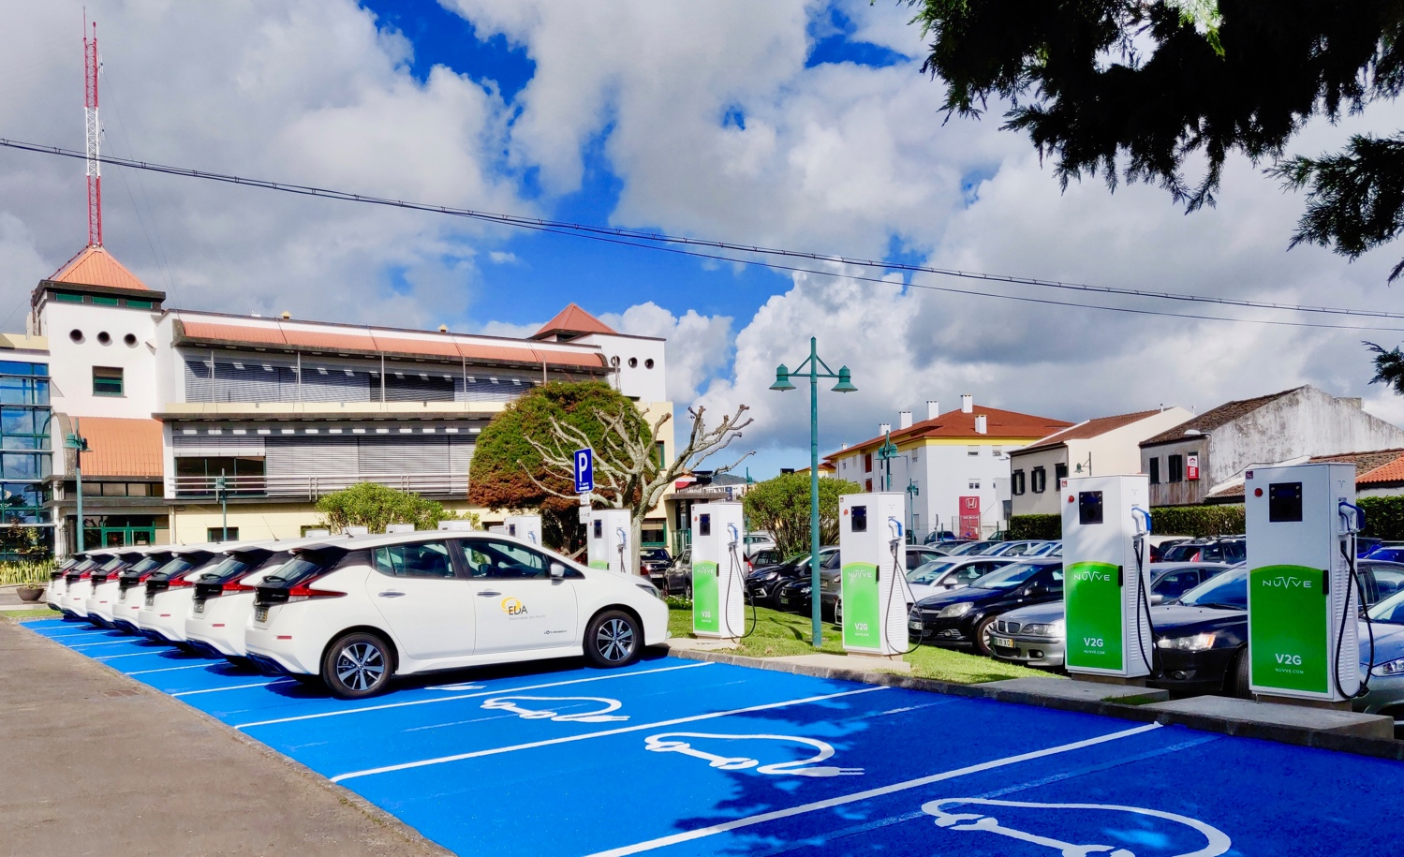

Who is Nuvve?
Nuvve’s proprietary vehicle-to-grid (V2G) technology enables the linking of multiple electric vehicle (EV) batteries through EV charging stations into a virtual power plant (VPP) providing bi-directional services to the electrical grid in a qualified and secure manner.
The company generates revenue from bidding onto energy markets and creates energy savings for its customers
Nuvve’s technology and ecosystem has proven to successfully lower the cost of electric vehicle ownership, while supporting the integration of renewable energy for a scalable and sustainable green society.

Slide 6

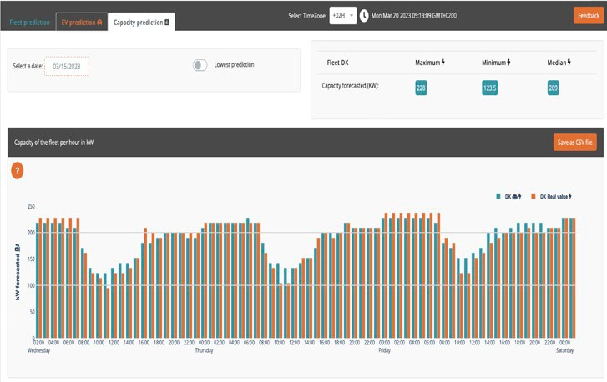


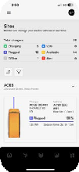

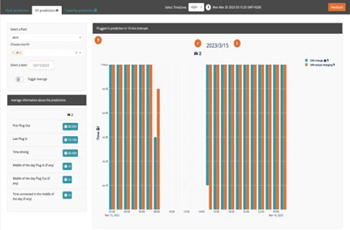
Company Overview
Business Overview | Nuvve’s vehicle-to-grid (V2G) SaaS technology platform dynamically manages power between EV batteries & the grid, driving recurring revenue off an expanding installed base
Core Technology | Developed over 2+ decades, the Company’s Grid Integrated Vehicle (GIVeTM) software utilizes advanced AI analytics to optimize fleet charging and interactions with the grid
Intellectual Property | Defensible IP portfolio, including 20 issued and pending patents across both their hardware and software offerings
Partners & Customers | Trusted to provide energy & grid services to the leading global utility and energy companies, as well as close technology development partnerships with Auto & Charging OEMs
Installed Base | 25 Megawatts under Management (MWuM) as of Dec 2023 for 160+ customers across 180+ customer sites, a 45% increase in MWuM from a year prior
Financial Profile | Robust business momentum, 2023 revenue of $8.33 M+ with key new customer wins
Key Stats: 2023 Rev +55% Over 2022*
55%
Jan 2024 YoY
Rev. Growth*
160+
Global Customers
47
Employees
20
Global Patents
Including 7 Pending
180+
Individual sites managed
25+ MW
Capacity under mgmt.
600+
EVSEs
Deployed
$8.33M
2023 Revenue
20+
Utility Partners
First innovator of Vehicle- to-Grid (V2G) technology, with the only true commercial deployments in the market to date
* Revenues for the year ended December 31st, 2023 increased 55% over the year ended december 31st, 2022

Slide 7
Our Mission
To lower the cost of electric vehicle (EV) ownership while supporting the integration of renewable energy for scalable and sustainable green society.
EV share (new global sales)
Wind/PV share (global capacity)
2%
15%
2018
2018
57%
52%
2040
2040
Source : BNEF

Slide 8

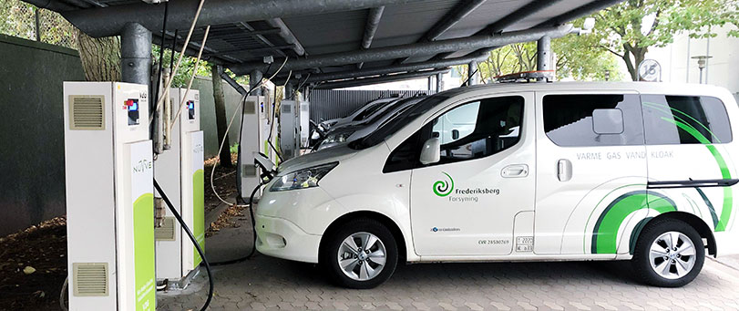
THE BIRTHPLACE OF COMMERCIAL V2G
Denmark
8+ years of continuous V2G operations in Denmark
Total of 43 light-duty vehicles located around the country
Commercial fleets, municipalities, and utilities
Grid services: frequency regulation
Supporting Danish offshore wind renewable integration to the grid

Slide 9
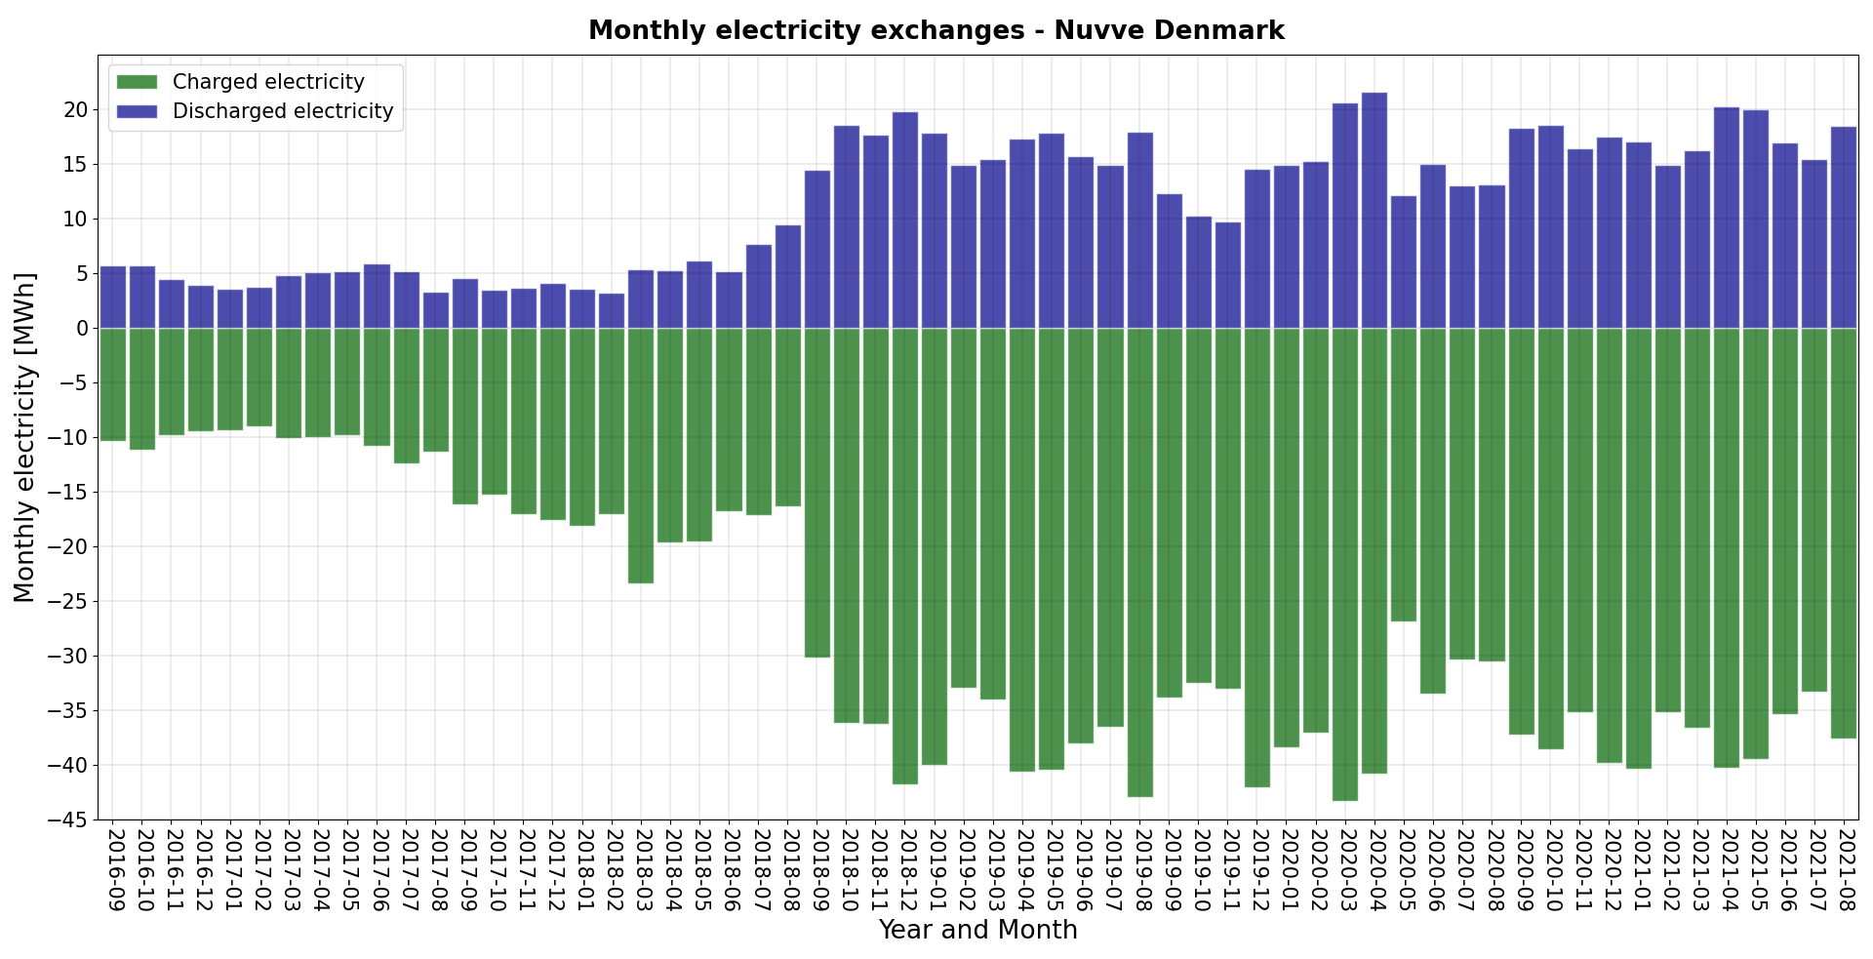
Energy in/out and Average Revenue Per EV
Average of $2,000 in revenue earned per EV per year
Variation affected by energy market prices and vehicles being aggregated
Year | Revenues per bid EV
2018 | $2,342 USD
2019 | $2,325 USD
2020 | $1,269 USD
2021 (until end of August) | $1,890 USD
Nissan Leaf battery size: 24 to 40kWh
Charging station capacity: 10kW
One sixth of a school bus

Slide 10
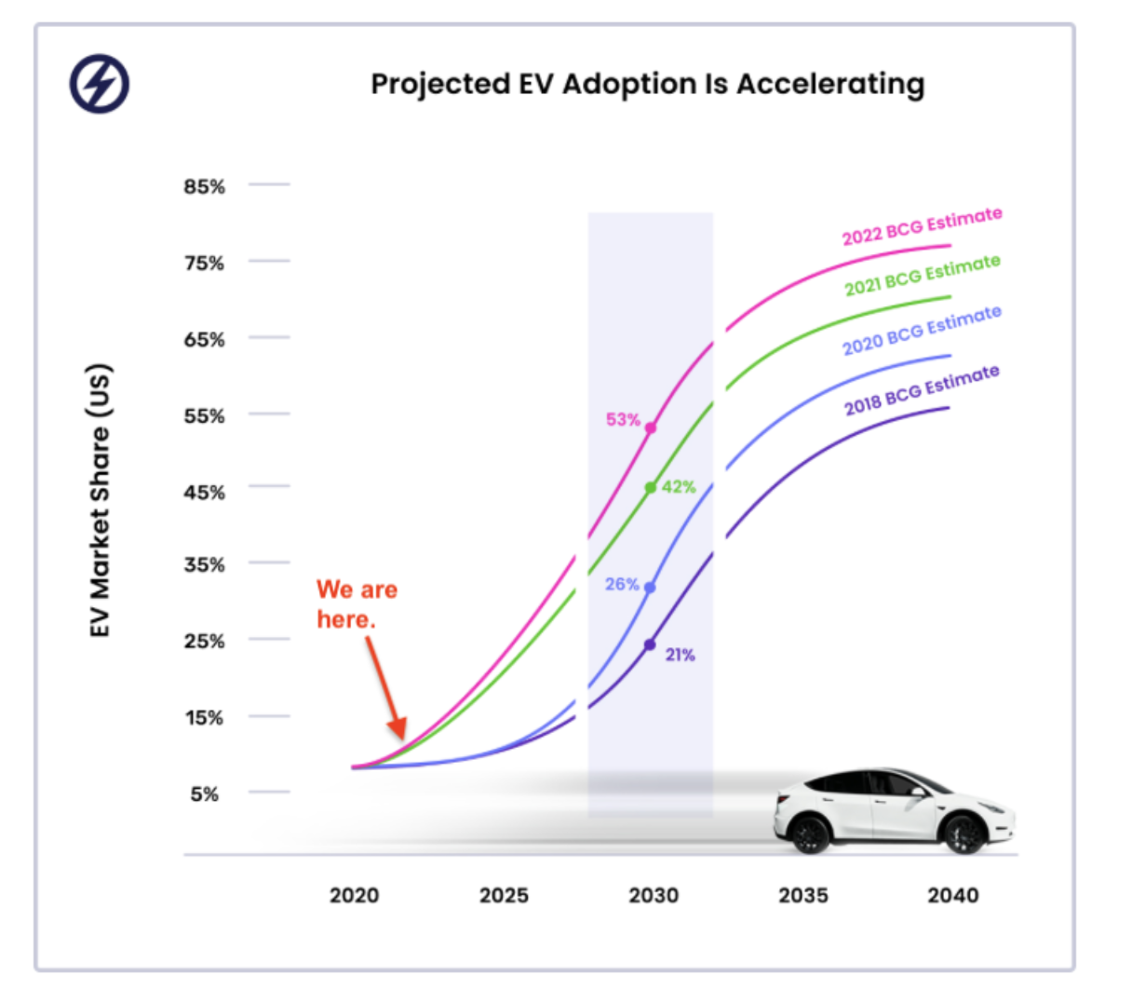
We Are Still Very Early In The EV Deployment

Slide 11
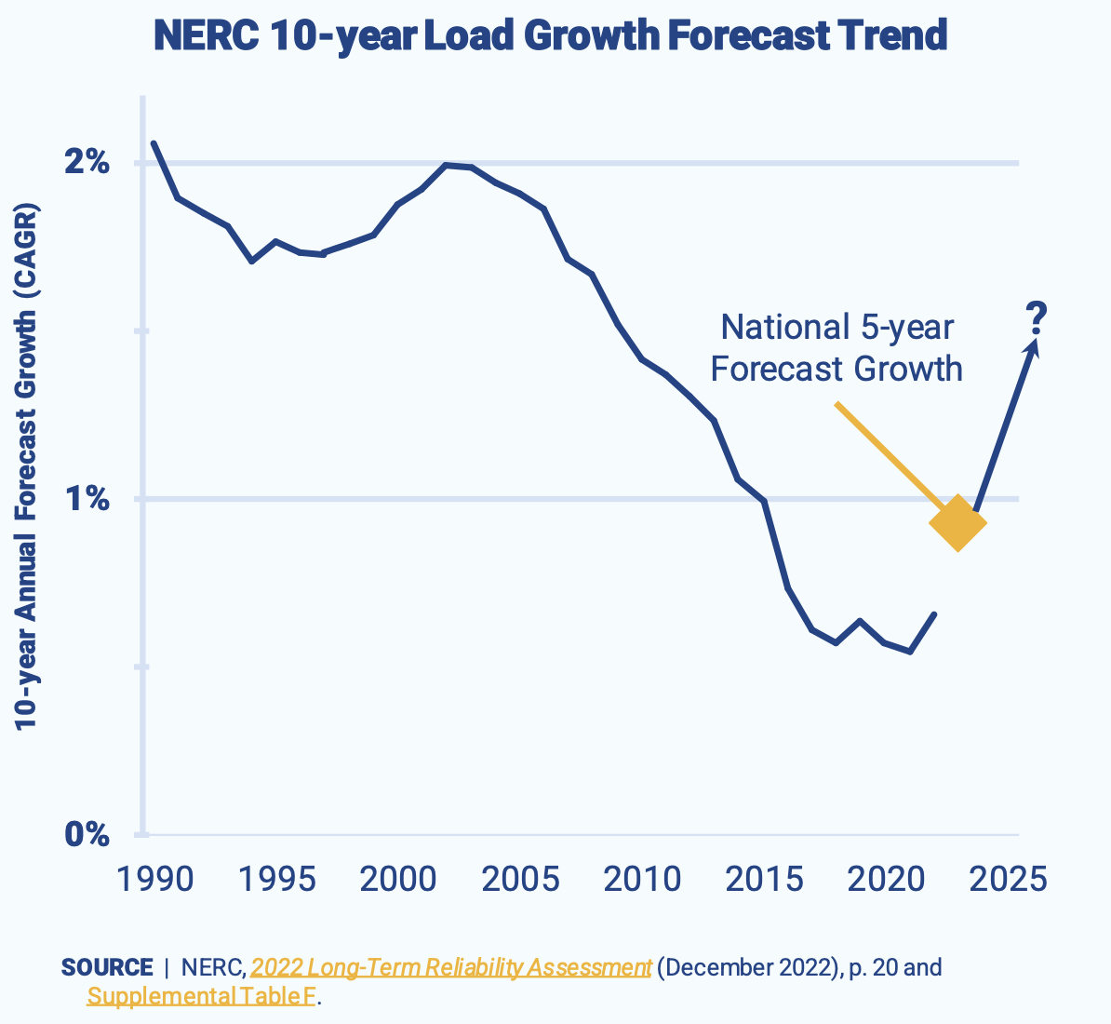
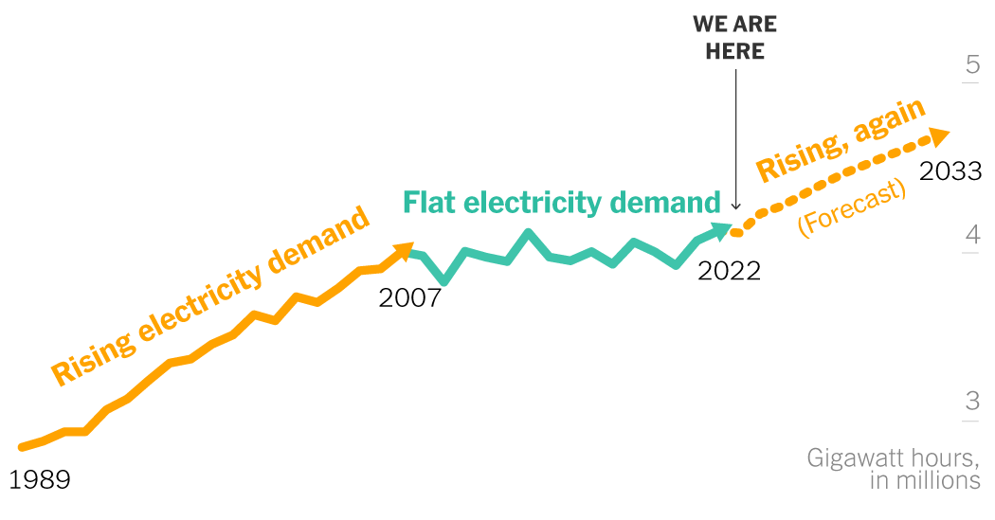
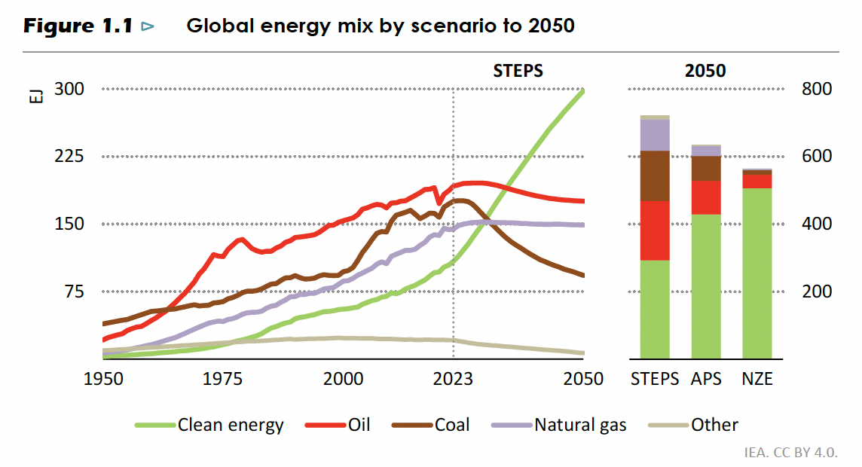
The New Paradigm
While we are transitioning to renewable generation, the load is increasing for the first time in 25 years
Growth is driven by heating, cooling, data centers and later one EV’s

Slide 12
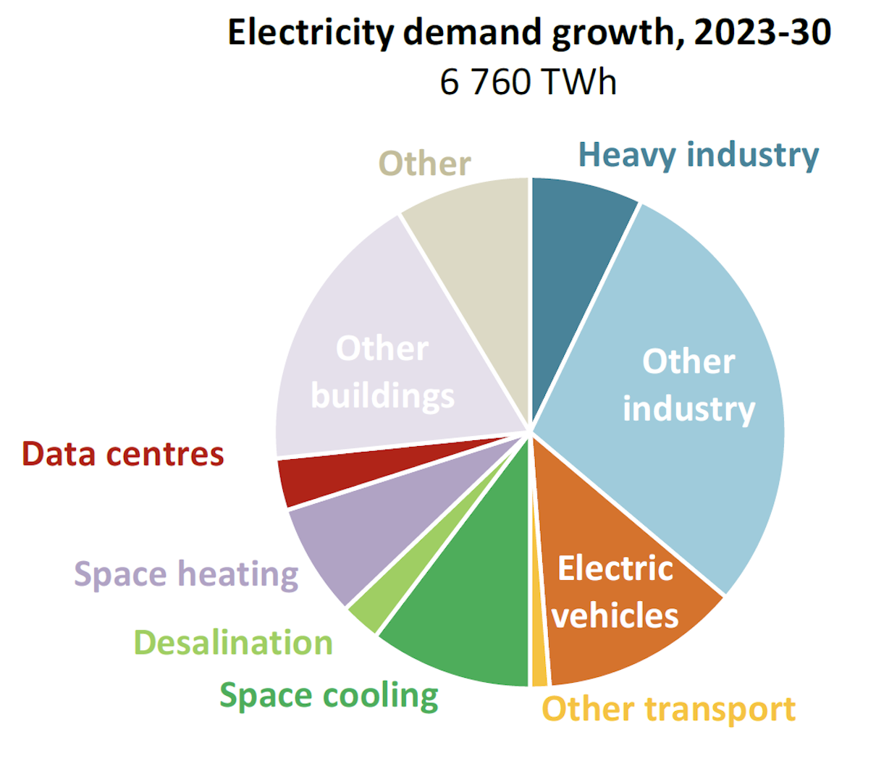
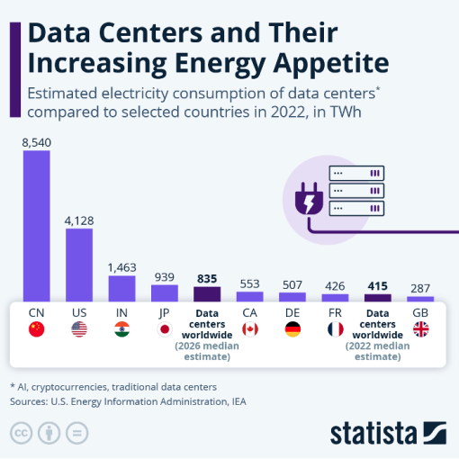
The New Loads
Growth driven by electrification and climate impact
https://www.intellinews.com/how-energy-intensive-are-data-centers-335244/

Slide 13
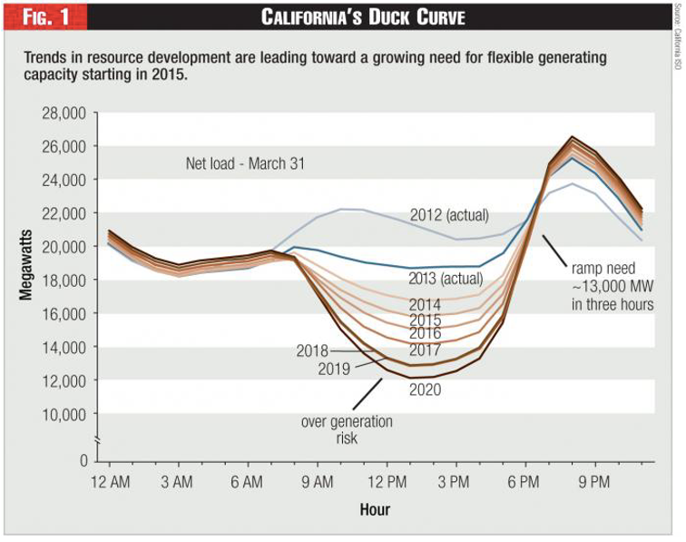
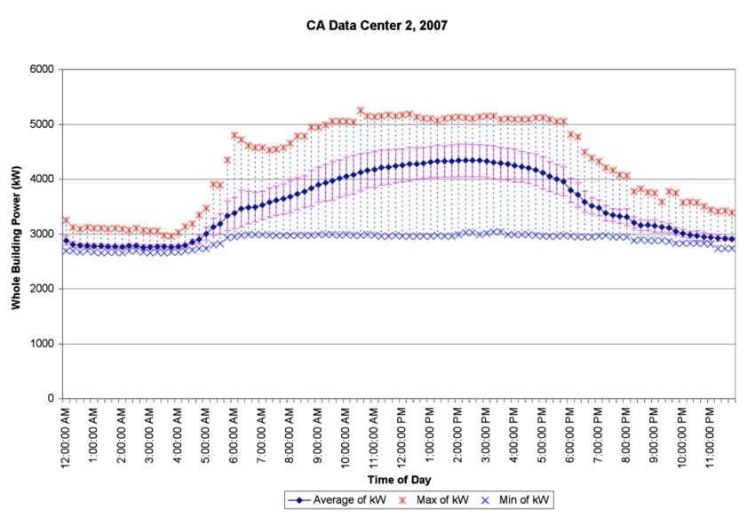
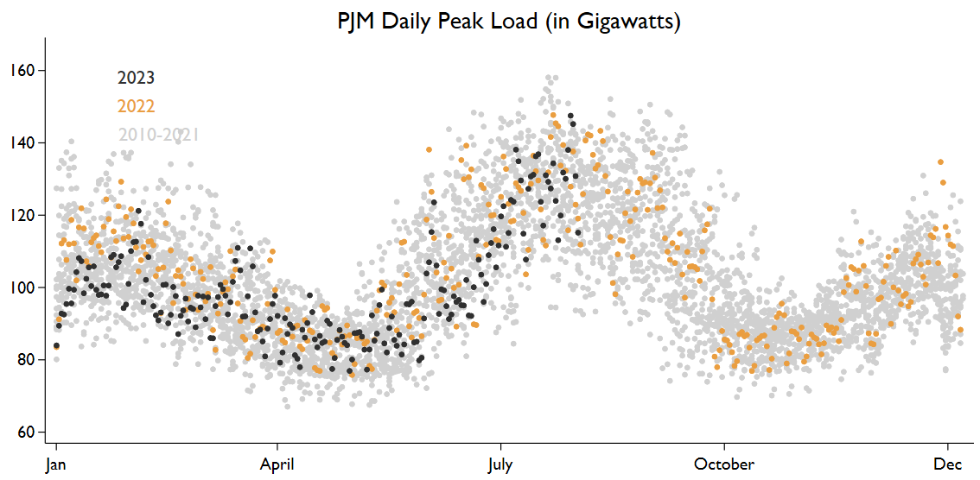
The Different Layers Of Volatility
Yearly
Daily
Hourly
https://energyathaas.wordpress.com/2023/03/13/californias-duck-belly-blues/
https://energyathaas.wordpress.com/2023/07/31/are-record-temperatures-causing-record-u-s-electricity-consumption/
https://www.researchgate.net/figure/Data-Center-2-Daily-Load-Shape-in-2007-Summer-and-Winter_fig2_255215593

Slide 14



Nuvve’s Platform And Services
Electric vehicles go from being unreliable resources into reliable, dispatchable and monetizable assets.
Reduces the cost of EV ownership, encourages EV adoption
Helps stabilize the grid with Nuvve’s bidirectional charging
Guarantees vehicle will be set for use by owner when needed
Optimizes and protects the vehicle battery
Enables increased renewable penetration
Notes:
The problem(s)
Grid instability – renewables
Making sure EVs are charged strategically/ green
Reduces cost of ownership --> increases # of vehicles on the road
Cost of EVs vs. ICEs
EVs are mobile and have other uses
Platform makes sure vehicles are ready for next use
Protects battery
Makes unreliable assets reliable

Slide 15

Nuvve Platform Implementation
GIVe™ Aggregator
AI Integration
Dispatch
Forecast
Bid
Report
Compatible w/ all standards
Control infrastructure directly or via API’s.
Vehicle-Based
Availability
Power capacity
Historic usage
Market-Based
Historical trends
Projected value
Volatility
Performance and Financial Results reporting to stakeholders (utilities, fleet owners, drivers)
DRIVER
GRID
BATTERY

Slide 16
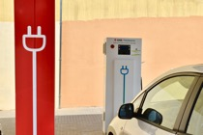
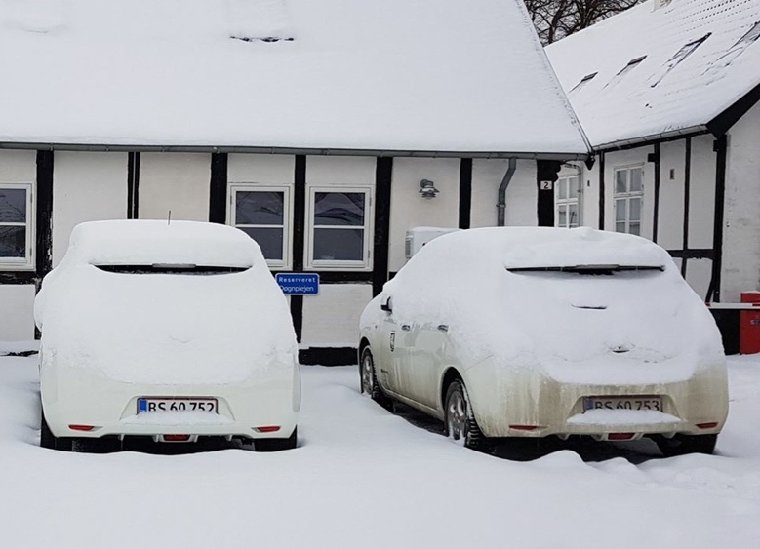
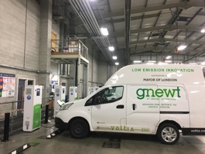
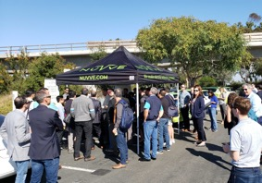
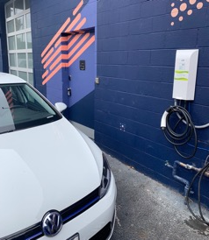
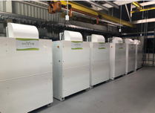
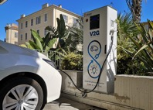
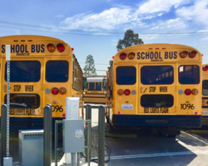
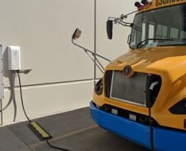
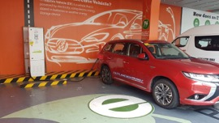
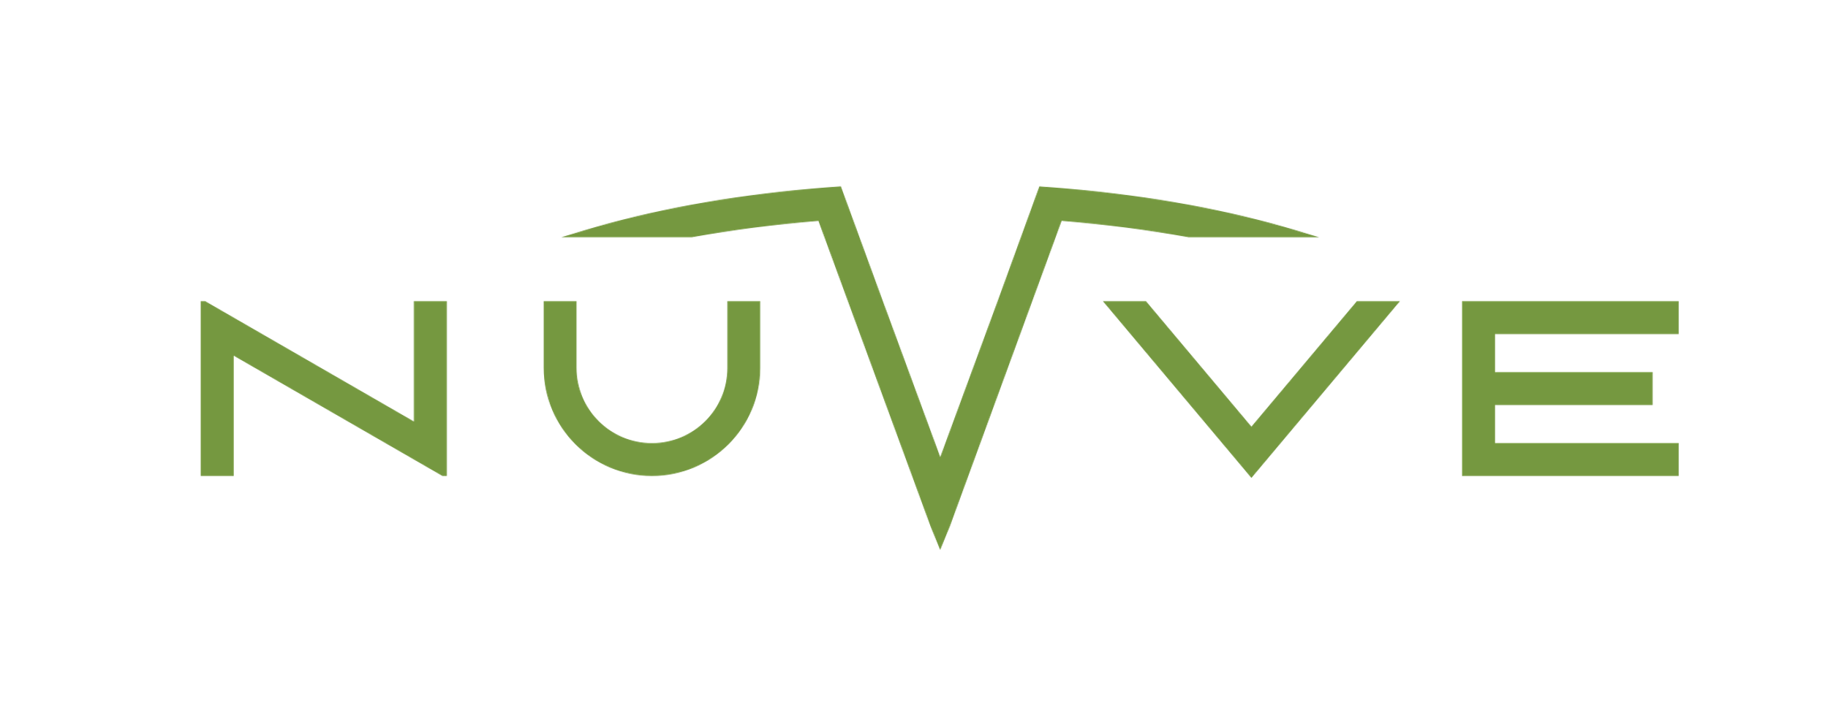
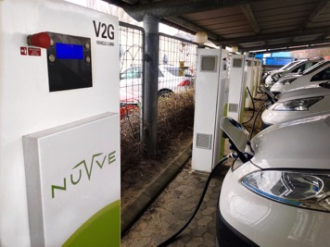
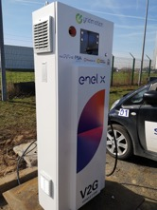
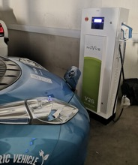

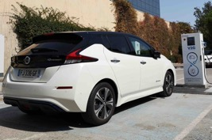
Barcelona, Spain
EVS32 Lyon, France
Bornholm, Denmark
London, UK
UCSD, San Diego CA
Culver City, CA
Newark, Delaware
V2G
Corsica, France
Torrance, CA
El Cajon, San Diego CA
Manila, Philippines
Nagoya, Japan
San Jose, CA
CDG Airport, Paris
Windhoek, Namibia
Nice, France
Frederiksberg, Denmark

Slide 17
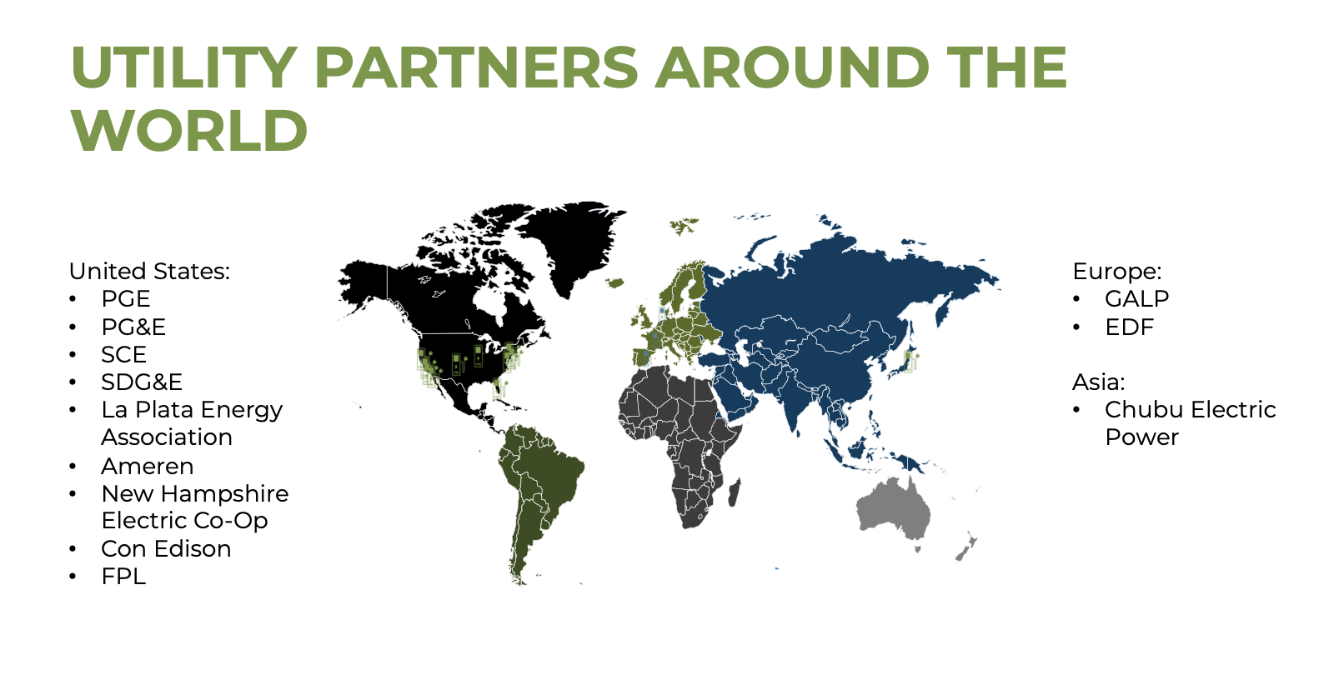

Slide 18
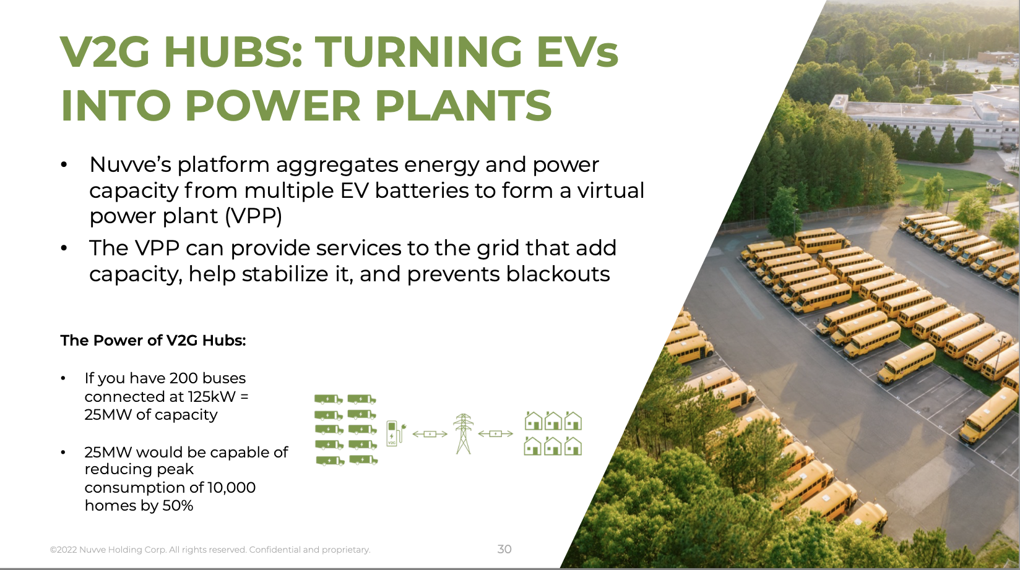

Slide 19




Value (Revenue) Proposition
Nuvve is capable of providing all levels of Vehicle Grid Integration, including V2G, providing revenues from grid services and uutility bill savings behind the meter.
Smart Charging
Value Proposition
Binary Stop/Start charge at scheduled times
TOU⁽¹⁾
V1G
Dynamic charge rate based on external signals
Demand Response
V2H / V2B
Demand Charge Management, Emergency Back-up
Bi-directional capable, connected to buildings, able to respond to tariff signals.
V2G
Wholesale Energy Market
(Ancillary, Capacity, Energy)
Interconnected energy storage that can respond to fast grid signals and participate in energy markets
Utility Interconnection
TOU = Time of Use Optimization

Slide 20
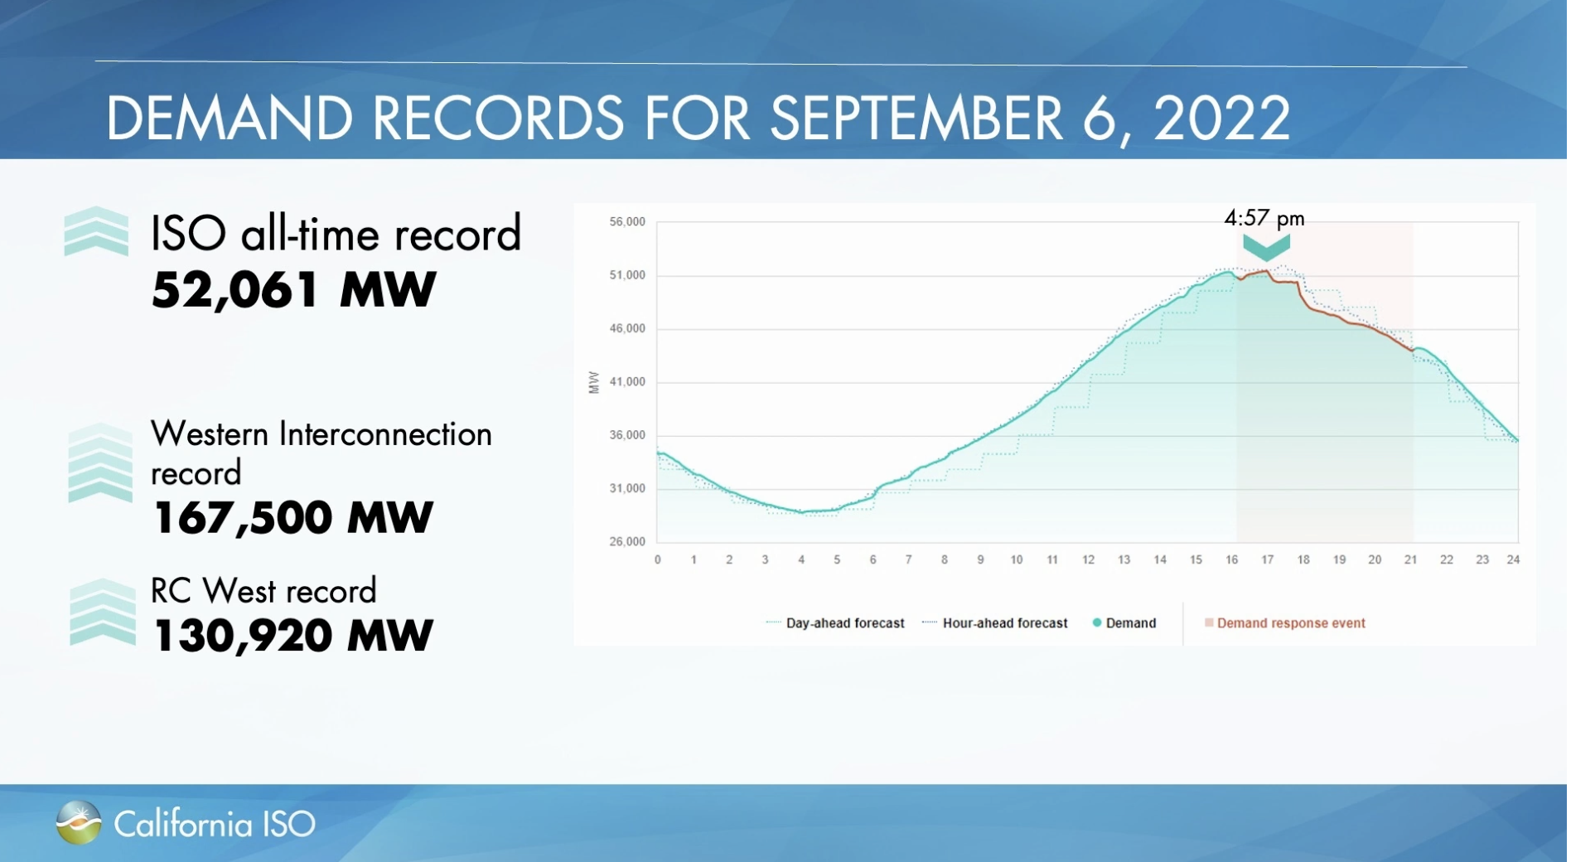
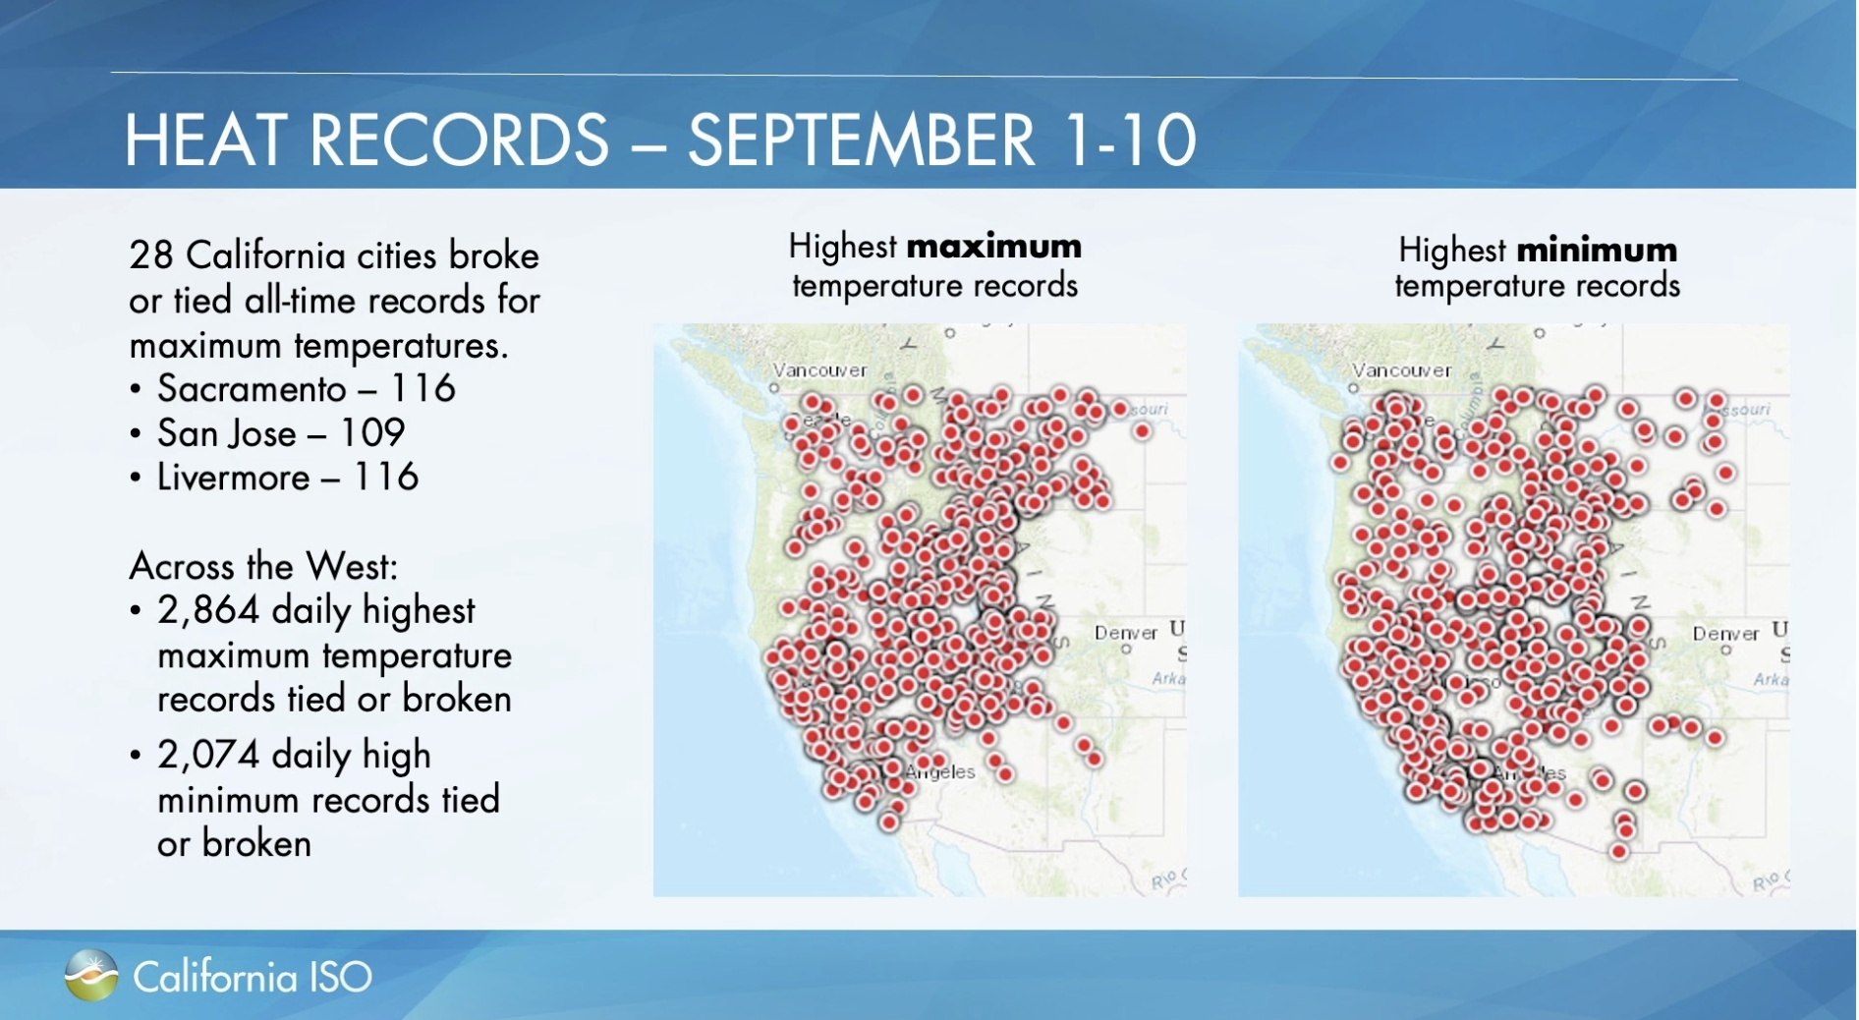
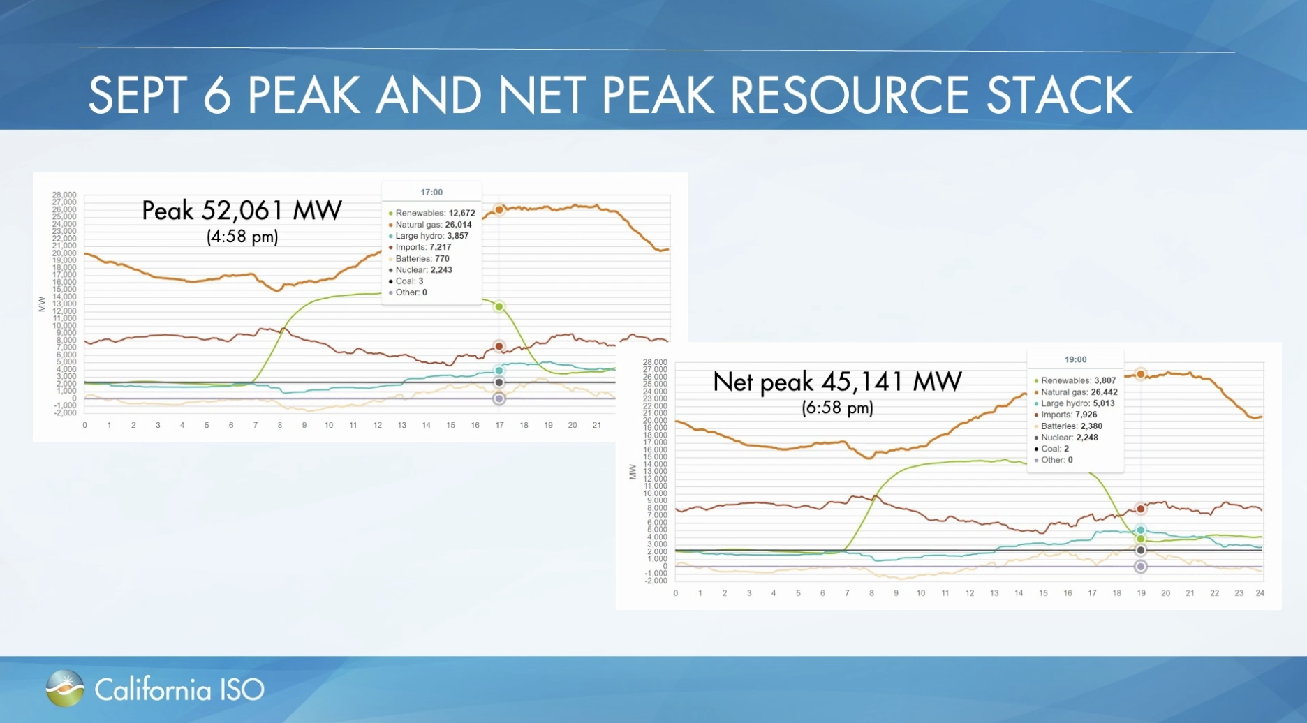
California Heat Wave Impact On The Grid
“The heat wave of September 2022 was one of the most challenging events in the history of the ISO grid.”
-Elliot Mainzer, CAISO President and CEO
Notes:
For reference, New Mexico’s grid also hit its all-time demand record in 2022…of about 10.2MW.

Slide 21

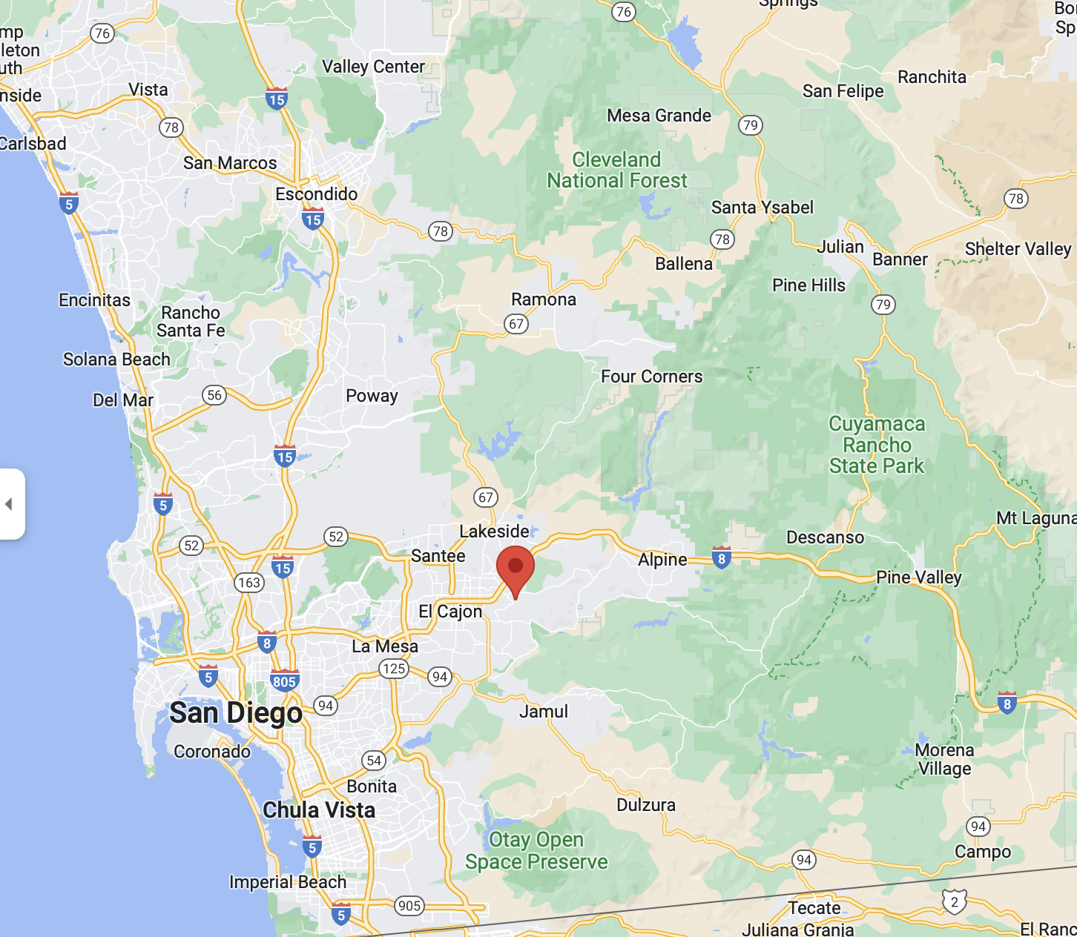
Host Site: Cajon Valley USD

Slide 22
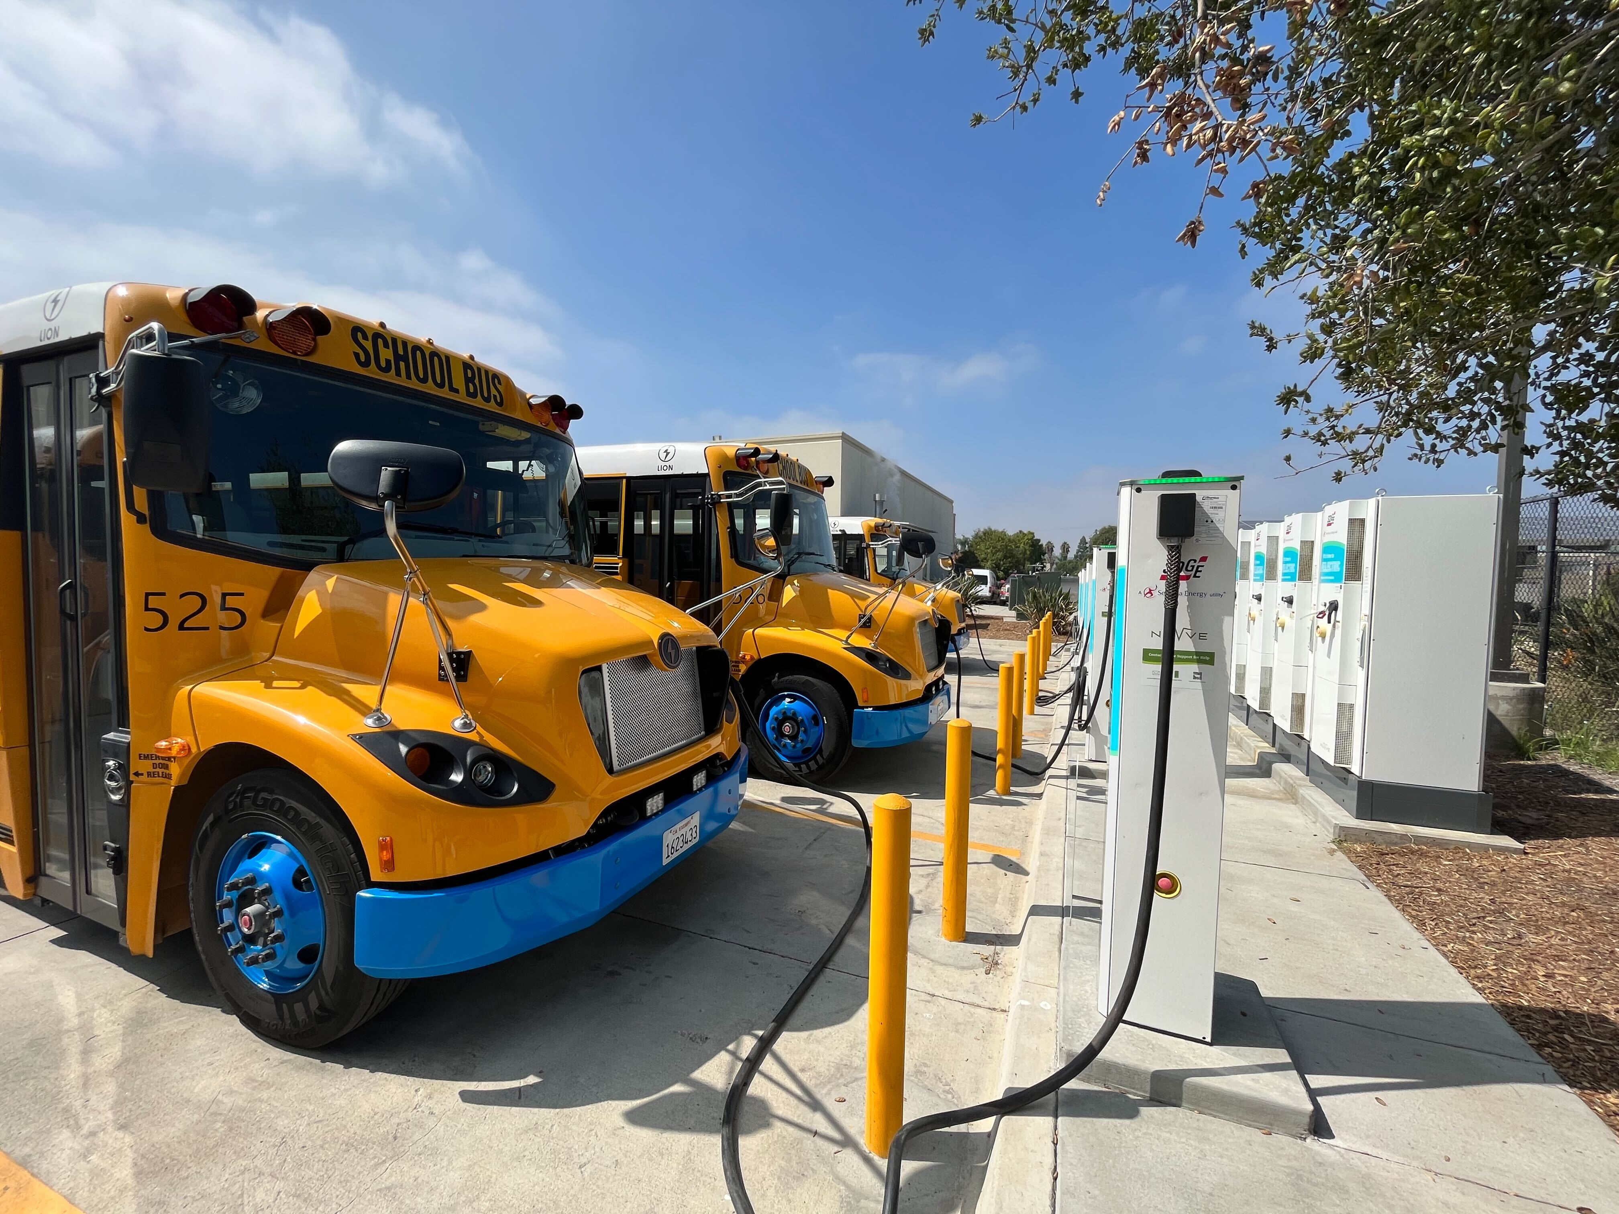
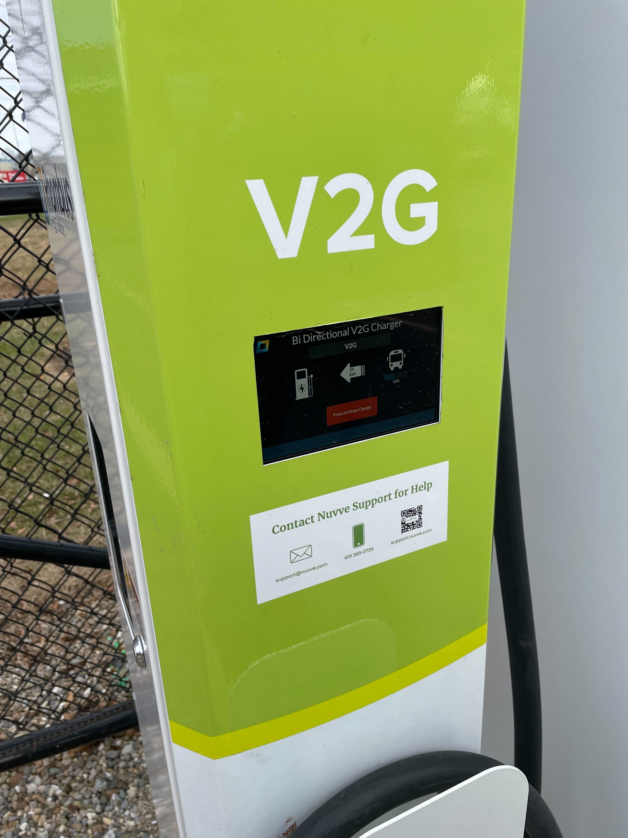
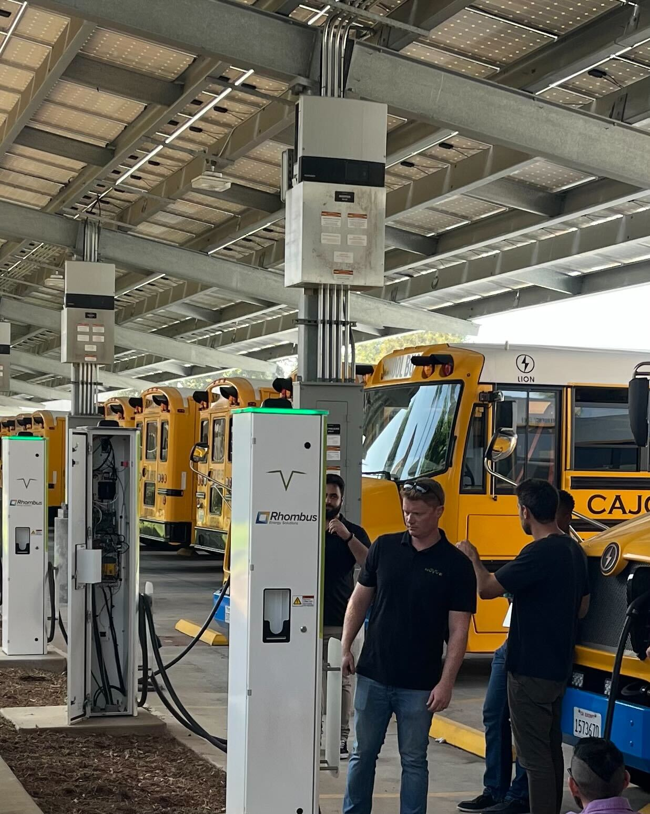
Cajon Valley USD

Slide 23
ELRP Program Results
Updated: 13Oct22
10 Events between 17 August and 09 September 2022
Notes:
Process
Input hours spent to date on projects
Estimated Grande and Venti based on % of total time applied
Estimated flat rate for Finance, partnerships, and sales
Scaled the hours based on % complete for the project
Applied the expected or deferred revenue from Finance Team for each project
Subtracted the cost (labor, material, and construction)
Divided total profit by total labor hours
Similar standard deviation between Tall and Grande but Tall remains the lowest – best “bang for your buck”
Consider a negative profit per labor hour as an investment in those areas – this analysis does not account for future revenue generated following the completion of the project

Slide 24

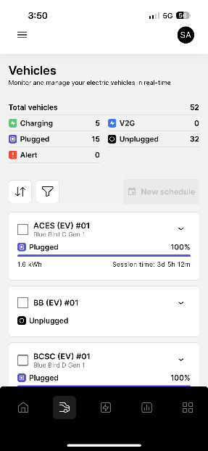
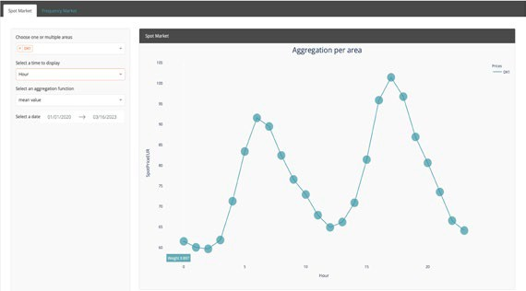
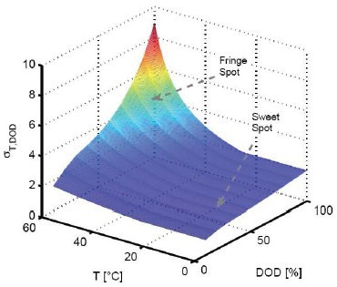
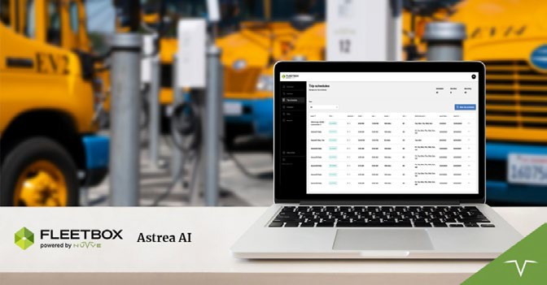

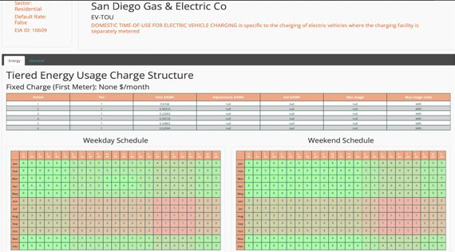
The Most Advanced EV Management Platform
GIVeTM is an incredibly flexible, futureproof and full-service platform that enables precise interaction between EV fleets and utility markets
Utilizes a purpose-built AI platform (Astrea AI) that forecasts fleet availability and aggregates energy capacity for grid operators to meet reliability needs
AI leverages information from multiple databases developed over decades to track utility tariffs and forecast market pricing with 97% accuracy
Key Platform Features
AI-Assisted Charge Management
Fleet Forecasting & Vehicle Readiness
Utility Tariff Database & Market Price Forecasting
Battery Life Optimization

Slide 25
Q & A
NUVVE.COM

Slide 26
THANK YOU
NUVVE.COM

