Slide 1
Driving Smarter: Fleet Telematics Solutions
Kevin Wood, Coordinator
Randy Wilde, Co-Coordinator
July 14, 2016

Slide 2
Clean Cities
U. S. Department of Energy Clean Cities Program
Mission - To advance the energy, economic, and environmental security of the U.S. by supporting local decisions to reduce petroleum use in transportation.
The San Diego Regional Clean Cities Coalition was established in 1996 to:
Build partnerships to support clean vehicle deployment
Promote alternative fuels including: Electricity, propane, natural gas, biodiesel and ethanol
Help fleets and consumers make informed decisions about fuel technologies
Notes:
San Diego Clean Cities is dedicated to reducing regional petroleum consumption and emissions through the deployment of alternative fuel and advanced technology vehicles. The Coalition‘s public, private, and nonprofit members work together to help fleets and consumers make informed choices on alternative fuels and fuel economy and overcome barriers to the greater adoption of clean transportation technologies.

Slide 3
Today’s Agenda
Introductions - 11:00 AM
What is telematics and how can it help me?
Solutions in Action - 11:15 AM
Hear from local fleets who have implemented telematics
Group Discussion - 11:45 AM
Vendor introductions, Q&A with fleet speakers and vendors
Networking Lunch - 12:15 PM
Enjoy a complimentary lunch, network with your peers, and interact with vendors

Slide 4
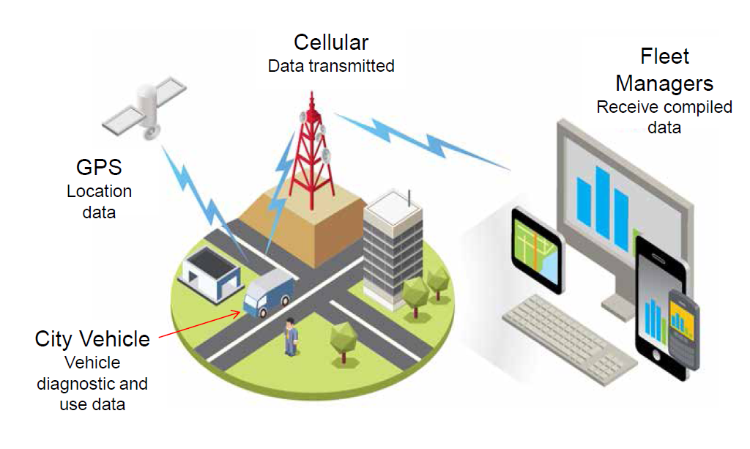
Telematics Basics
Position
Current location
Path of travel
Geofencing
Utilization
Trips
Miles driven
Idling
Safety
Speeding
Hard braking or acceleration
Maintenance
Diagnostics
Smog check

Slide 5
Save Fuel and Money
Improve routing
Utilization and right-sizing
Minimize risk and improve safety
Optimize maintenance schedules
Reduce idling and inefficient driving practices
Notes:
Add specific notes from Natalie

Slide 6
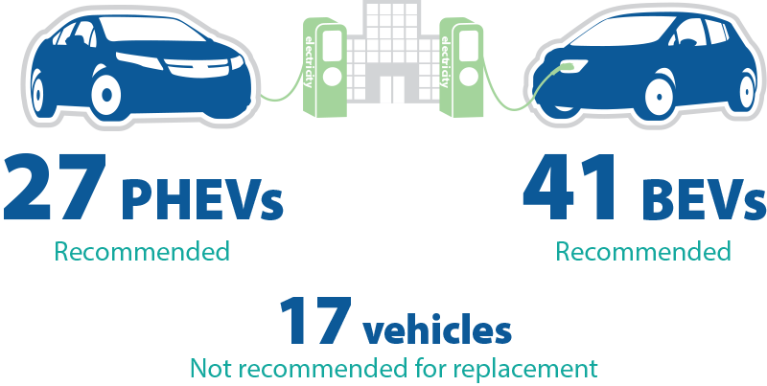
Integrating Alternative Fuels
Telematics can help you:
Know your vehicles so you can make smart decisions
Assess suitability and cost of alternative technologies
Match the right fuel to the right application

Slide 7
Fleet Speakers
Michael Simonds, Fleet Repair Supervisor
City of San Diego
Ron Bent, Equipment Superintendent
Caltrans
Bradley Northup, Fleet Acquisitions Coordinator
County of San Diego

Slide 8
Vendor Speakers
Yukon Palmer, Founder
Field Technologies
Adam McCarty, Commercial Leader
Lytx DriveCam
Jerry Leatherman, National Account Manger
Geotab
Dan Zdarko, Business Account Manager
Verizon Networkfleet

Slide 9
Today’s Vendors
Fieldlogix: fieldtechnologies.com
FleetCarma: fleetcarma.com
Geotab: geotab.com
GPS Insight: gpsinsight.com
Lytx DriveCam: lytx.com
Verizon Networkfleet: networkfleet.com
Teletrac: teletrac.com

