Slide 1


2024 Q1 - Fleet Manager Roundtable
02/29/2024
San Diego Regional Clean Cities Coalition (SDRCCC)
Francis Alvarez, Co-director
John Anderson, Co-director

Slide 2
Agenda
10:00 AM – San Diego Clean Cities Introduction
Guest Introductions (name, title & organization)
Policy Updates
10:30 AM – Helix Water District Presentation
11:00 AM – Site Walk
12:00 PM – Lunch
1:00 PM – Further Discussion
1:45 PM – Event Closeout
2:00 PM – Adjourn

Slide 3
San Diego Regional Clean Cities Coalition Fleet Manager Roundtable
Policy Update – February 2024
Kinshuk Chatterjee, Senior Transportation Policy Analyst

Slide 4
Updates
Advanced Clean Fleets (ACF)
1
CARB will not be enforcing ACF until U.S. EPA grants waiver request.
Low Carbon Fuel Standard (LCFS) Amendments
2
5
CARB issues Proposed Amendments to change infrastructure credit pathways and support MD/HD fleets.
New CPUC Proceeding and Infrastructure Program
3
6
CPUC opens new transportation proceeding and begins development on MD/HD infrastructure program.

Slide 5

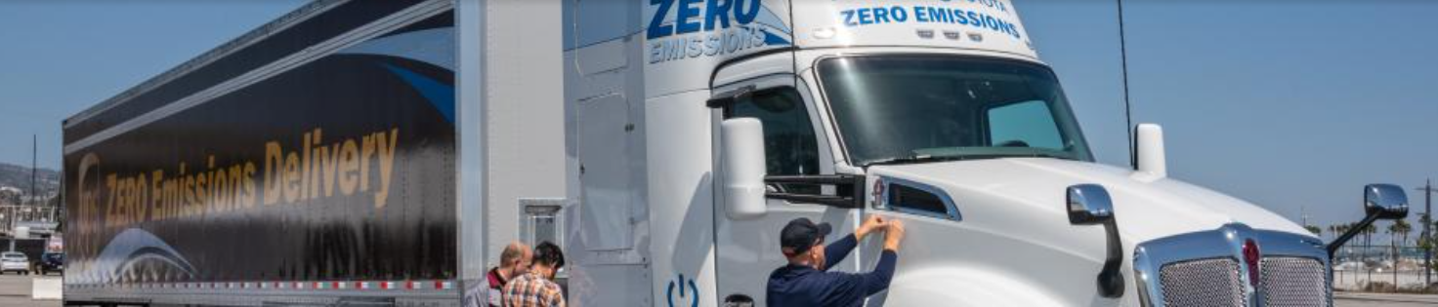
Advanced Clean Fleets (ACF)
Response to Lawsuit – In response to the California Trucking Association’s (CTA) lawsuit and requests for injunctions to the ACF, CARB has taken the following actions:
In a letter to CTA, CARB clarified that it has sent a preemption waiver request to U.S. EPA and is currently waiting for the request to be granted or deemed unnecessary.
In a public enforcement notice, CARB expressed that it will not be enforcing any of the ACF’s drayage or high priority fleet reporting requirements until the waiver is granted.
CARB encourages fleets to voluntary comply with reporting requirements, since these requirements will be applied retroactively if the waiver is granted.
Truck Regulation Implementation Group (TRIG) – CARB held an outreach-focused TRIG meeting on 2/26/24 and will hold additional meetings throughout March.

Slide 6
Low Carbon Fuel Standard (LCFS) Amendments
Overview – In January 2024, CARB issued the Proposed Amendments to the LCFS program:
Clean Fuel Reward (CFR) Program – CARB has proposed amending the CFR program to provide point-of-sale incentives for MD/HD vehicles (as opposed to light-duty vehicles).
Utility credit revenues – CARB has proposed reducing the amount of utility credit revenues directed to the CFR program, which would result in greater funding for utility programs.
Fast Charging Infrastructure (FCI) credit pathway – CARB has proposed expanding the FCI pathway to operators of MD/HD chargers and limiting the FCI pathway to light-duty chargers in disadvantaged, low-income, or rural communities.
LCFS Credit Price Projections – As detailed in Table 16 (page SRIA-49) of Standardized Regulatory Impact Assessment, CARB has estimated the impacts of the amendments on LCFS credit prices.
Timeline – Stakeholder comments were filed through February 20, 2024. CARB will be holding a public workshop to discuss the amendments in March 2024 and will hold a CARB Board Meeting to consider adopting the amendments sometime after.

Slide 7

New CPUC Proceeding and Infrastructure Program
New TE Proceeding – In December 2023, the CPUC opened a new rulemaking proceeding (R.23-12-008) to oversee transportation electrification (TE) issues like grid planning and energization.
The proceeding is expected to issue decisions on these issues in 2024.
New BTM Program – In November 2022, the CPUC adopted a Decision which established the Funding Cycle 1 (FC1) Behind-the-Meter (BTM) Rebate Program, which will provide EV infrastructure incentives and technical assistance services. The development and design of this program began in January 2024.
The FC1 BTM Rebate Program will provide incentives for EV infrastructure and make-ready efforts, for both MD/HD vehicles and light-duty vehicles in multifamily homes.
The FC1 BTM Rebate Program will fund up to $1 billion in incentives over a five-year period.
BTM Workshop – The Investor-Owned Utilities (IOUs) held the first Technical Assistance Services workshop for the BTM Program on 2/28/24 (materials may be posted to the CPUC’s TE webpage).

Slide 9
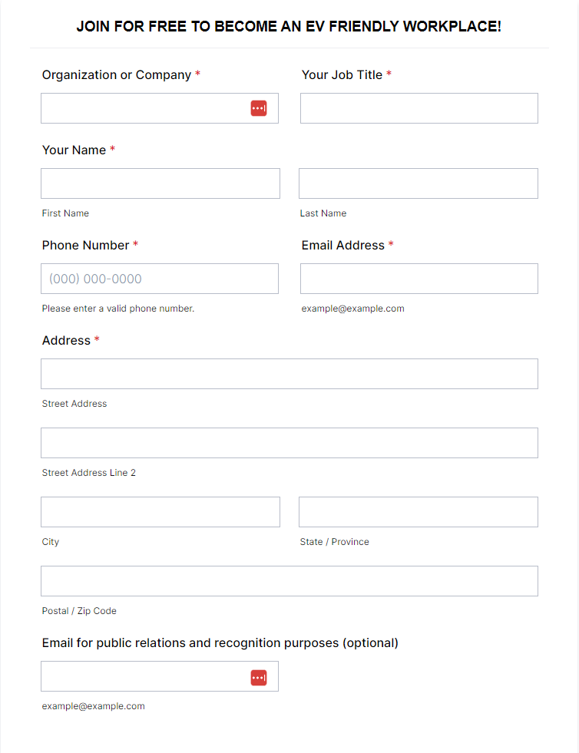
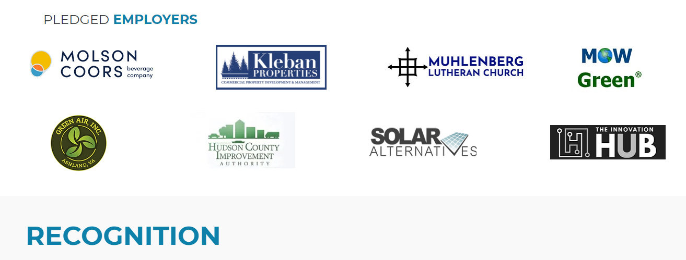
EMPOWER – Workplace Charging Pledge
Sign a pledge to receive the following:
Clean Cities technical support
Recognition for being an EV-friendly workplace

Slide 10
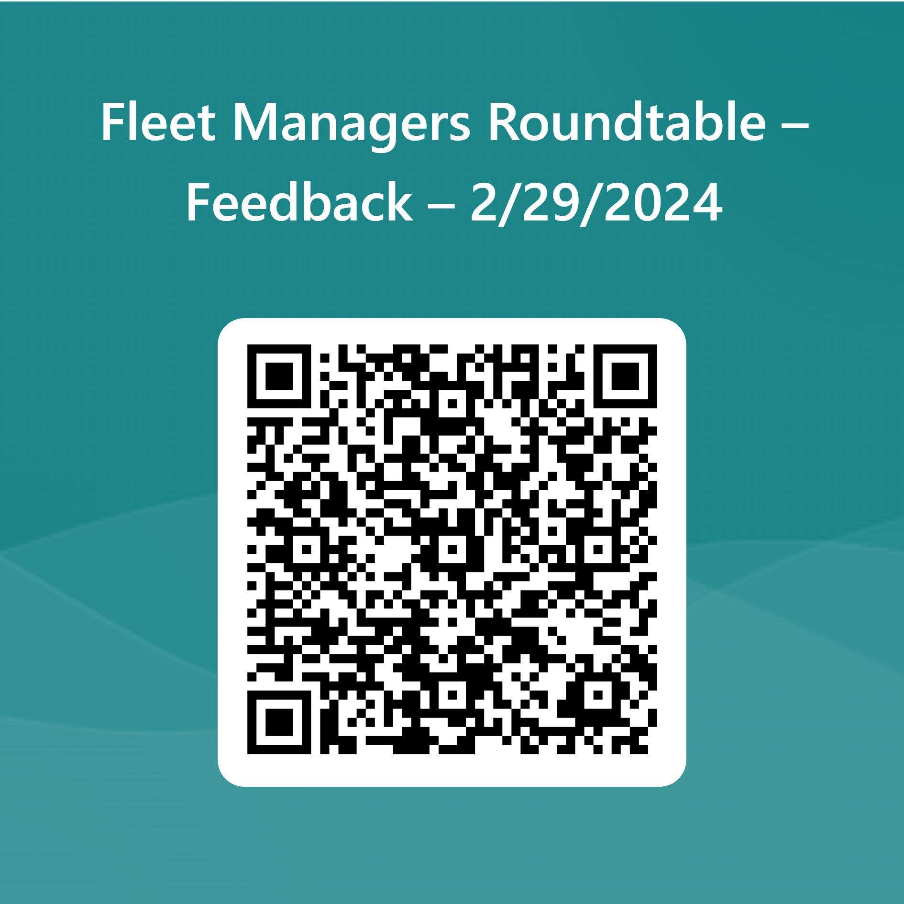
Website: https://sdcleancities.org/
Email:
sdrccc@energycenter.org
If you're interested in learning more about being recognized as an EV-friendly workplace or hosting the next event, please see Francis.
https://forms.office.com/r/JBvVfpFxuM

