Slide 1
TEAS
Transportation Electrification Advisory Services
January 2025

Slide 2
Clean Transportation Programs
Power Your Drive for Fleets (PYDFF)
Transportation Electrification Advisory Services (TEAS)
Rule 15, 16 and 45
Provides no to low-cost infrastructure for Medium- and Heavy- Duty Fleets.
Two customer options:
  Option 1: No Cost Installation for infrastructure
  Option 2: Low Cost Installation with a rebate of up to 80%.
Program administered by Clean Transportation.
Provides Advisory Services to Medium- and Heavy-Duty Fleets.
Complimentary guidance and support is provided to medium- and heavy-duty fleets.
Services help guide the customer along the electrification journey.
Program administered by Clean Transportation.
R15: Distribution Line Extension
R16: Service Extension
R45: EV Infrastructure Rule
Infrastructure can be used to for light-, medium-, and/or heavy- duty electric vehicle charging.
Program administered by DPM.

Slide 3
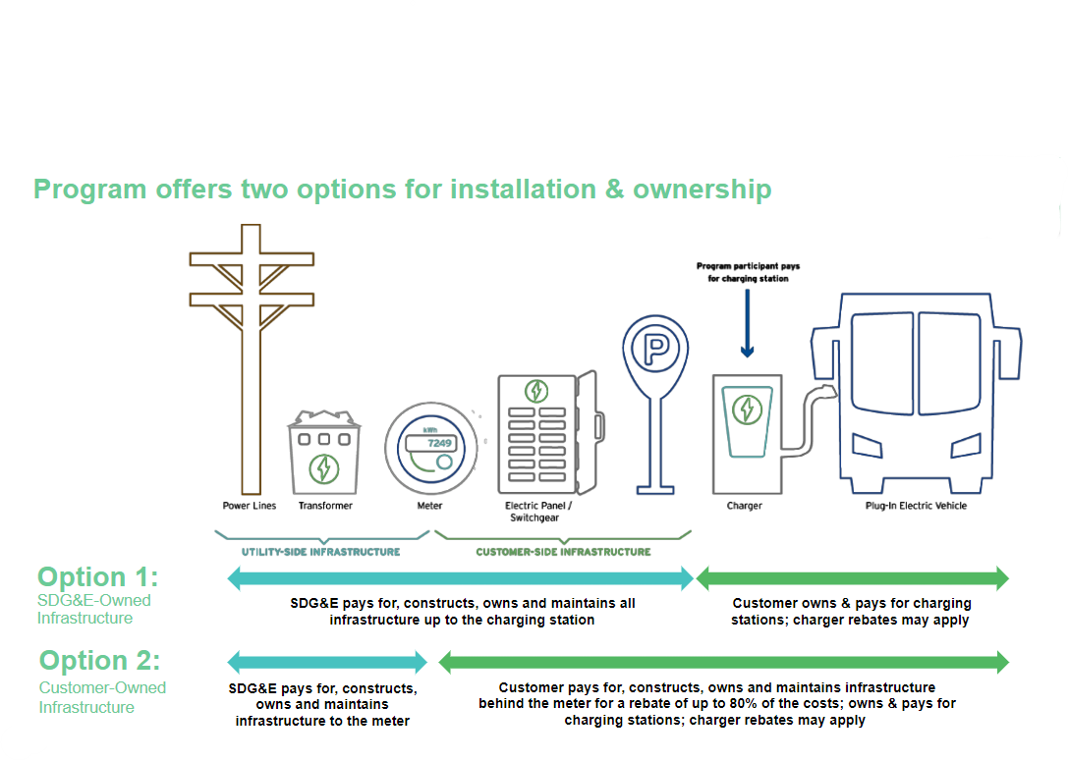
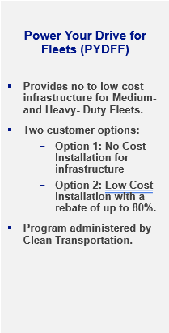
Clean Transportation Programs
Power Your Drive for Fleets
Notes:
Applied for extension. Other IOUs have applied and received approval for extension.

Slide 4
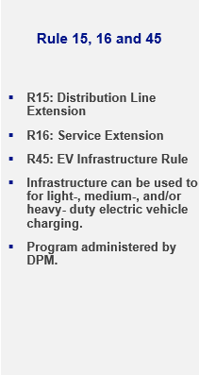
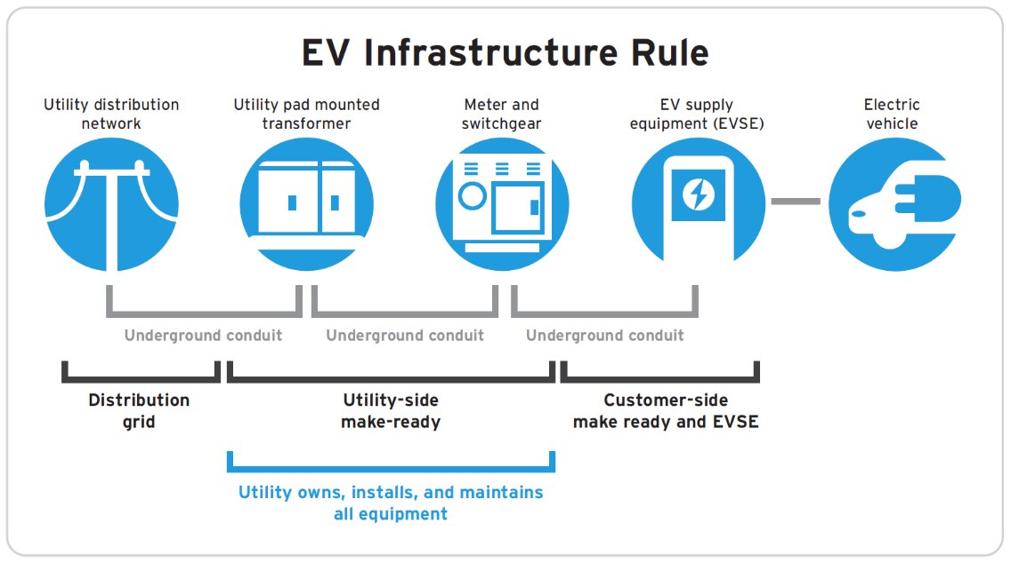
Electric Vehicle/New Business Pathways
Rules 15, 16 and 45

Slide 5
Transportation Electrification Advisory Services (TEAS)
Program Overview
A new kind of utility offering: Comprehensive electrification Advisory Services for medium- and heavy-duty fleets
Approved by the Commission November 30, 2023
  3-year implementation timeline
  $17.8 million program
Complimentary advisory support for fleet customers tailored to meet their needs in whatever phase of electrification they are in, regardless of their eligibility for other SDG&E programs.
Open to all customers with 50% of program budget focused on supporting Underserved Communities with prioritized Advisory Services for these customers. Outreach led by Community-Based Organizations (CBOs).

Slide 6

Transportation Electrification Advisory Services (TEAS)
Who is a TEAS Customer?
Medium & Heavy-Duty Fleets with a facility in SDG&E’s service area
Fleets at every stage of their electrification journey—from initial planning to post-energization– can benefit from TEAS
Priority Customer Segments Include:
  Small Businesses
  Schools
  Tribes
  Transit Agencies
  Municipalities

Slide 7
Transportation Electrification Advisory Services (TEAS)
What are the TEAS Advisory Services?
TEAS Advisory Services are divided in four “stages” of support:
SDG&E TEAS Advisory Services
Fleet Electrification Planning | Support navigating where to start with vehicle selection, charging infrastructure options, and load planning.
Pre-Energization Support | Guidance on infrastructure capacity and providing liaison within SDG&E departments.
Post-Energization Support | Assistance to effectively manage energy consumption, maintain infrastructure, and optimize rates.
Emerging Technology Consulting | Help integrating innovative solutions including Automated Load Management (ALM) and V2X (Vehicle-to-Everything) technologies.

Slide 8
Transportation Electrification Advisory Services (TEAS)
TEAS Program Timeline
Q4 2023
Program
Approved
Q2 2024
Program
Soft Launch
2024-2025
Program
Build Out
Q1 2025
Anticipated Program Launch
Q3 2025
CBO
Engagement
Mid 2026
Program
Application Deadline
Program officially approved
Began receiving initial customer interest
Build and refine customer portal and service offerings
Through a comprehensive Marketing, Education, and Outreach campaign
Focused outreach led by Community Based Organizations (CBOs)
Customer applications will be accepted through 2026
Notes:
Will have through 2027 to serve customers, just not new applications after mid-2026

Slide 9
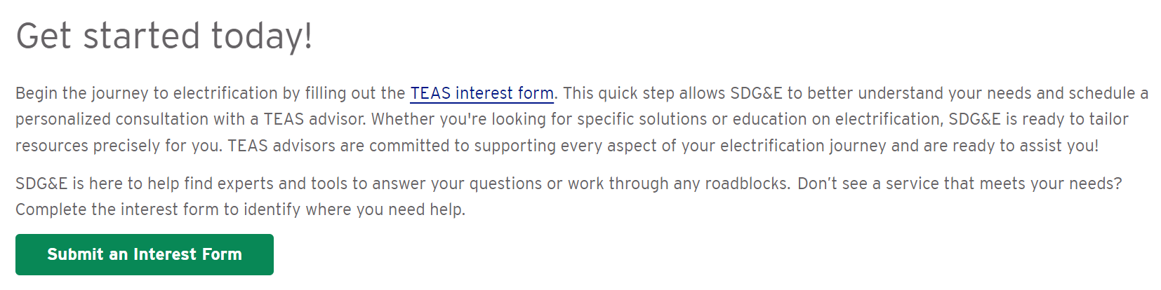
Transportation Electrification Advisory Services (TEAS)
Next Steps
Who can TEAS help?
Medium/heavy-duty fleets transitioning at least one vehicle to zero-emission
Prospective site in SDGE territory

Slide 10



Transportation Electrification Advisory Services

Slide 11
Transportation Electrification Advisory Services (TEAS)
Thank You!
TEAS Team Leads
Your TEAS program points of contact going forward
Eva Brungardt | Lead TEAS Advisor
EBrungar@sdge.com
Manages all incoming TEAS customer inquiries.
Lianna Rios | EV Customer Solutions Manager
LHRios@sdge.com
Supports and facilitates all incoming TEAS customer requests.
Maura Eisele | TEAS Project Manager
MEisele@sdgecontractor.com
Project Manager for the TEAS program.
Notes:
=

